Slide 2
Global TMI:
Disciple-Making Evangelism

Slide 3
Total Member Involvement

Slide 4
A Biblical Strategy for Disciple-Making Evangelism

Slide 5
WHAT IS GLOBAL TMI?
Global TMI is a call for every church and every member to become actively involved in making disciples using Christ’s method.

Slide 6
THE LAUNCH
Every Seventh-day Adventist local church across the world is invited to launch this ongoing, culture-changing, personal and public evangelism strategy, which includes holding evangelistic reaping meetings in 2024 and/or 2025

Slide 7
GLOBAL TMI IS LOCAL
Total Member Involvement (TMI) is a global initiative, but its success depends on the faithful efforts of pastors and lay leaders in local churches.

Slide 8
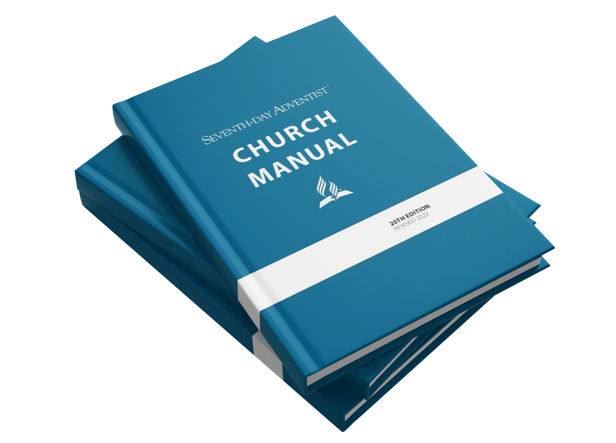

Slide 9
“Encourage the personal ministries department to enlist all members and children in some form of personal outreach (missionary) service”
(p. 138).

Slide 10
“When the board devotes its first interests and highest energies to involving every member in proclaiming the good news and making disciples, most problems are alleviated or prevented…” (p. 135).

Slide 11
“Its chief concern [church board] is having an active discipleship plan in place, which includes both the spiritual nurture of the church and the work of planning and fostering evangelism”
(p. 134-135).

Slide 12
“The board is responsible to: 1. Ensure that there is an active, ongoing discipleship plan in place, which includes both spiritual nurture and outreach ministries. This is the most important item for the board’s attention” (p. 137).

Slide 13
THE DISCIPLESHIP PLAN
(p. 134-135, 137)
A single plan

Slide 14
THE DISCIPLESHIP PLAN
(p. 134-135, 137)
A single plan
Active and ongoing

Slide 15
THE DISCIPLESHIP PLAN
(p. 134-135, 137)
A single plan
Active and ongoing
Outreach ministries

Slide 16
THE DISCIPLESHIP PLAN
(p. 134-135, 137)
A single plan
Active and ongoing
Outreach ministries
Spiritual nurture

Slide 17
THE DISCIPLESHIP PLAN
(p. 134-135, 137)
A single plan
Active and ongoing
Outreach ministries
Spiritual nurture
“chief concern”

Slide 18
THE DISCIPLESHIP PLAN
(p. 134-135, 137)
A single plan
Active and ongoing
Outreach ministries
Spiritual nurture
“chief concern”
“most important item”

Slide 19
THE DISCIPLESHIP PLAN
In harmony with the Church Manual, Global TMI provides a single framework for the local church’s discipleship plan that includes both outreach ministries and spiritual nurture.

Slide 20
STRATEGY OVERVIEW

Slide 21
EQUIPPING THE CHURCH
Emphasize spiritual revival

Slide 22
SPIRITUAL REVIVAL
“Nothing is more needed in our work than the practical results of communion with God.”
Gospel Workers, p. 510

Slide 23
EQUIPPING THE CHURCH
Emphasize spiritual revival
Establish an interest review process

Slide 24
INTEREST REVIEW PROCESS
“Let every church member become a working member, to build up spiritual interests.”
Evangelism, p. 64

Slide 25
“Encourage the interest coordinator to ensure that every interest is personally and promptly followed up by assigned laypersons”
(p. 137).

Slide 26
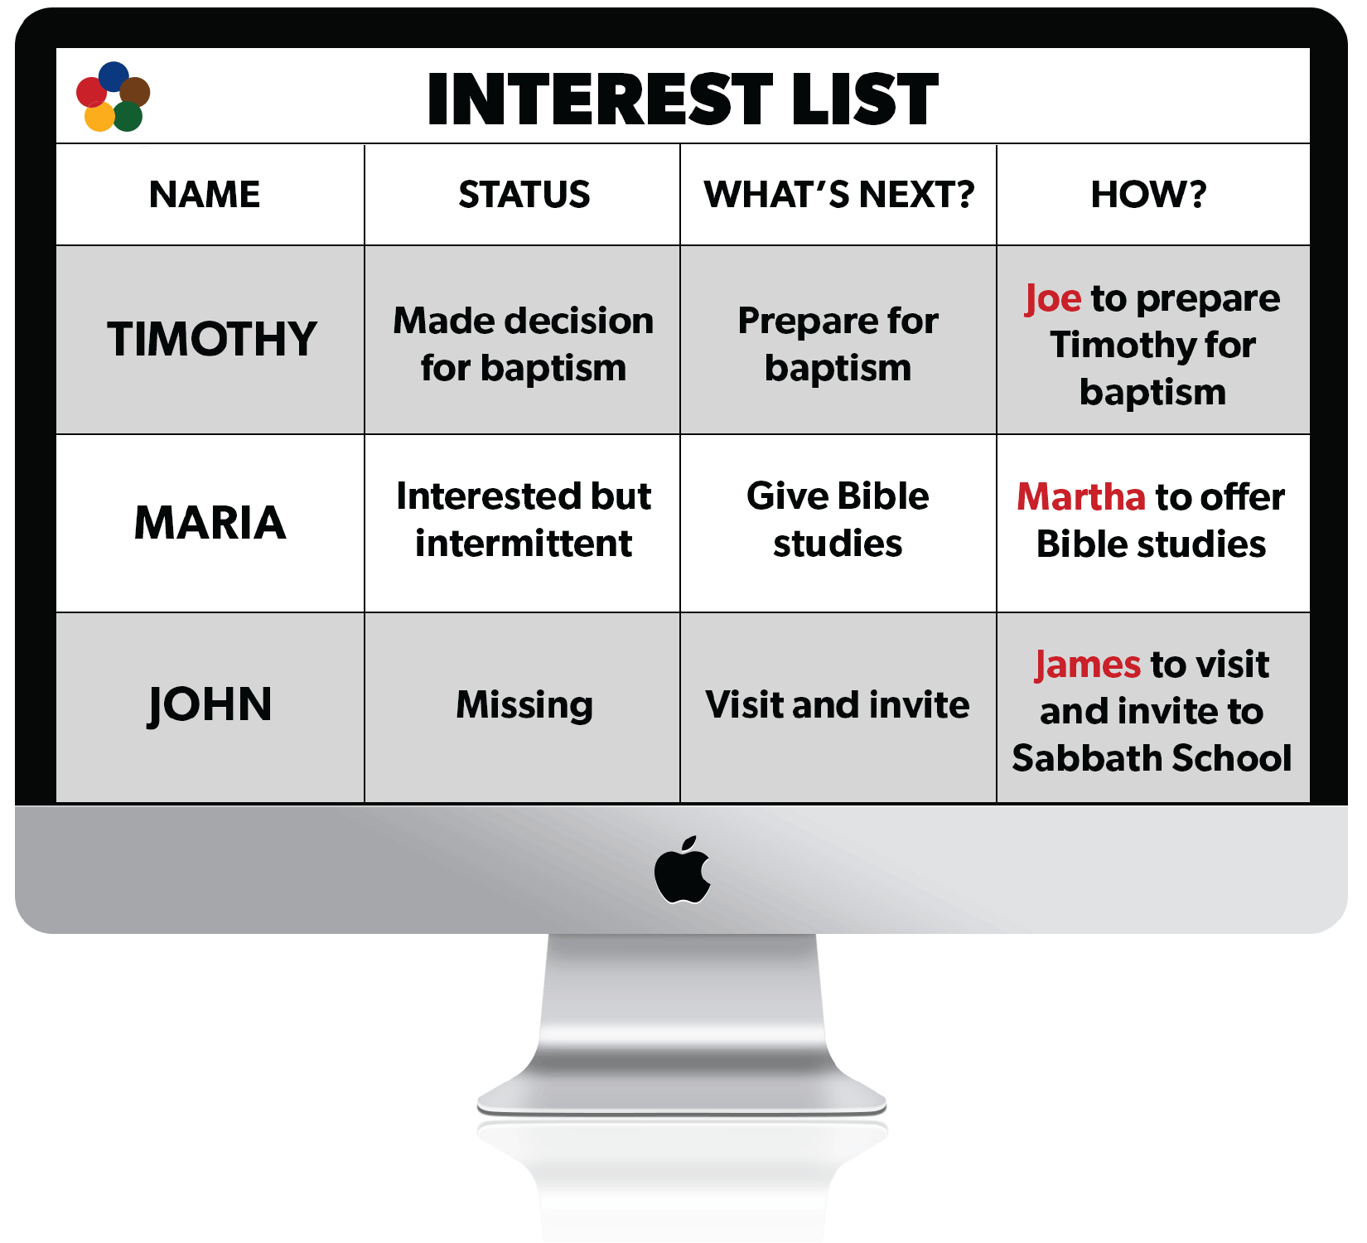
Interest Review Process

Slide 27
EQUIPPING THE CHURCH
Emphasize spiritual revival
Establish an interest review process
Provide personal evangelism training

Slide 28
PERSONAL EVANGELISM TRAINING
“Many would be willing to work if they were taught how to begin. They need to be instructed and encouraged. Every church should be a training school for Christian workers.”
The Ministry of Healing, p. 149

Slide 29
“Training classes should be conducted in various lines of outreach ministry”
(p. 138).

Slide 30
A SINGLE, ACTIVE, ONGOING DISCIPLESHIP PLAN

Slide 31
PREPARE
the soil of the heart

Slide 32
PREPARE
the soil of the heart
How?
Befriend people and minister to practical needs.

Slide 33
PREPARE
the soil of the heart
Health and Friendship
Building Ministries

Slide 34
THE DISCIPLE-MAKING JOURNEY
Friendship Interest

Slide 35
IS IT ESSENTIAL?
“And when Jesus went out He saw a great multitude; and He was moved with compassion for them, and healed their sick.”
Matthew 14:14

Slide 36
IS IT ESSENTIAL?
“No line is to be drawn between the genuine medical missionary work and the gospel ministry. These two must blend. They are not to stand apart as separate lines of work.”
A Call to Medical Evangelism and Health Education, p. 44

Slide 37
IS IT ESSENTIAL?
“The sowers of the seed have a work to do in preparing hearts to receive the gospel.”
Christ’s Object Lessons, p. 57

Slide 38
PLANT
seeds of truth

Slide 39
PLANT
seeds of truth
How?
Invite people to consider spiritual truth.

Slide 40
PLANT
seeds of truth
Literature, Media, and
Invitation Ministries

Slide 41
THE DISCIPLE-MAKING JOURNEY
Friendship Interest
Spiritual Interest

Slide 42
IS IT ESSENTIAL?
“He who sows sparingly will also reap sparingly, and he who sows bountifully will also reap bountifully.”
2 Corinthians 9:6

Slide 43
IS IT ESSENTIAL?
“Unvarnished truth must be spoken, in leaflets and pamphlets, and these must be scattered like the leaves of autumn.”
Testimonies for the Church, vol. 9, p. 231

Slide 44
IS IT ESSENTIAL?
“Everyone who has heard the invitation is to echo the message from hill and valley, saying, ‘Come.’”
The Acts of the Apostles, p. 110

Slide 45
CULTIVATE
spiritual interests

Slide 46
CULTIVATE
spiritual interests
How?
Engage people in a series of
full-message Bible studies.

Slide 47
CULTIVATE
spiritual interests
Bible Study Ministry

Slide 48
THE DISCIPLE-MAKING JOURNEY
Friendship Interest
Spiritual Interest
Study Interest

Slide 49
IS IT ESSENTIAL?
“So Philip ran to him, and heard him reading the prophet Isaiah, and said, ‘Do you understand what you are reading?’ And he said, ‘How can I, unless someone guides me?’”
Acts 8:30-31

Slide 50
IS IT ESSENTIAL?
“There are those in the world who are reading the Scriptures, but who cannot understand their import. The men and women who have a knowledge of God are needed to explain the word to these souls.”
Christian Service, p. 142

Slide 51
IS IT ESSENTIAL?
“Let ministers teach church members that in order to grow in spirituality, they must carry the burden that the Lord has laid upon them—the burden of leading souls into the truth.”
Christian Service, p. 69

Slide 52
HARVEST
decisions for Christ

Slide 53
HARVEST
decisions for Christ
How?
Appeal to people to follow Christ and
Bible truth and to be baptized.

Slide 54
HARVEST
decisions for Christ
Evangelistic Meetings

Slide 55
THE DISCIPLE-MAKING JOURNEY
Friendship Interest
Spiritual Interest
Study Interest
Baptismal Interest

Slide 56
IS IT ESSENTIAL?
“If there is not a decided application of the truth to their hearts, if words are not spoken at the right moment, calling for decision from the weight of evidence already presented, the convicted ones pass on without identifying themselves

Slide 57
IS IT ESSENTIAL?
“with Christ, the golden opportunity passes, and they have not yielded, and they go farther and farther away from the truth, farther away from Jesus and never take their stand on the Lord’s side.”
Evangelism, p. 283

Slide 58
IS IT ESSENTIAL?
“Too much hasty work is done in adding names to the church roll. . . . Those who admit them say, ‘We will first get them into the church, and then reform them.’ But this is a mistake.”
Review & Herald, May 21, 1901

Slide 59
PRESERVE
the harvest

Slide 60
PRESERVE
the harvest
How?
Nurture new members, train them in evangelism, and integrate them into the life and mission of the church

Slide 61
PRESERVE
the harvest
New Member
Discipleship Training

Slide 62
THE DISCIPLE-MAKING JOURNEY
Friendship Interest
Spiritual Interest
Study Interest
Baptismal Interest
Disciple-Maker-in-training

Slide 63
“When we are successful in the work of soulsaving, those who are added to the faith will, in turn, use their ability in giving the truth to others.”
Testimonies for the Church, vol. 9, p. 85

Slide 64
IS IT ESSENTIAL?
“A disciple is not above his teacher, but everyone who is perfectly trained will be like his teacher.”
Luke 6:40

Slide 65
IS IT ESSENTIAL?
“After individuals have been converted to the truth, they need to be looked after. . . . These newly converted ones need nursing—watchful attention, help, and encouragement.”
Evangelism, p. 351

Slide 66
IS IT ESSENTIAL?
“When souls are converted, set them to work at once. And as they labor according to their ability, they will grow stronger.”
Evangelism, p. 355

Slide 67
A SINGLE, ACTIVE, ONGOING DISCIPLESHIP PLAN

Slide 68
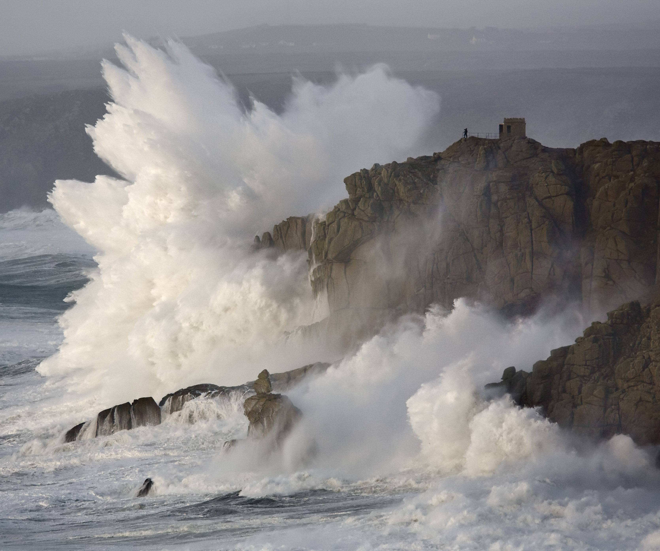
A BIG
SPLASH

Slide 69
MORE THAN
A BIG
SPLASH

Slide 70
ACTIVE AND ONGOING
Church Manual, p. 137
Leadership personnel
Budget
Resources
Annual Plan

Slide 71
ACTIVE & ONGOING (Church Manual, p. 137)
PREPARE
PLANT
CULTIVATE
HARVEST
PRESERVE

Slide 72
ACTIVE & ONGOING (Church Manual, p. 137)
PREPARE
PLANT
CULTIVATE
HARVEST
PRESERVE
Health Ministries Leader
(p. 100)
Community Services Leader
(p. 107)

Slide 73
ACTIVE & ONGOING (Church Manual, p. 137)
PREPARE
PLANT
CULTIVATE
HARVEST
PRESERVE
Health Ministries Leader
(p. 100)
Community Services Leader
(p. 107)
Publishing Ministries Coordinator
(p. 102)
Personal Ministries Assistant
(p. 107)

Slide 74
ACTIVE & ONGOING (Church Manual, p. 137)
PREPARE
PLANT
CULTIVATE
HARVEST
PRESERVE
Health Ministries Leader
(p. 100)
Community Services Leader
(p. 107)
Publishing Ministries Coordinator
(p. 102)
Personal Ministries Assistant
(p. 107)
Bible
School Coordinator
(p. 107)
Interest
Coordinator
(p. 107)

Slide 75
ACTIVE & ONGOING (Church Manual, p. 137)
PREPARE
PLANT
CULTIVATE
HARVEST
PRESERVE
Health Ministries Leader
(p. 100)
Community Services Leader
(p. 107)
Publishing Ministries Coordinator
(p. 102)
Personal Ministries Assistant
(p. 107)
Bible
School Coordinator
(p. 107)
Interest
Coordinator
(p. 107)
Pastor and Church Board
(p. 138)
Personal Ministries Leader
(p. 107)

Slide 76
ACTIVE & ONGOING (Church Manual, p. 137)
PREPARE
PLANT
CULTIVATE
HARVEST
PRESERVE
Health Ministries Leader
(p. 100)
Community Services Leader
(p. 107)
Publishing Ministries Coordinator
(p. 102)
Personal Ministries Assistant
(p. 107)
Bible
School Coordinator
(p. 107)
Interest
Coordinator
(p. 107)
Pastor and Church Board
(p. 138)
Personal Ministries Leader
(p. 107)
Personal Ministries Leader
(pp. 106-107)
Personal Ministries Assistant
(p. 107)

Slide 77
ACTIVE & ONGOING (Church Manual, p. 137)
PREPARE
PLANT
CULTIVATE
HARVEST
PRESERVE
Health Ministries Leader
(p. 100)
Community Services Leader
(p. 107)
Publishing Ministries Coordinator
(p. 102)
Personal Ministries Assistant
(p. 107)
Bible
School Coordinator
(p. 107)
Interest
Coordinator
(p. 107)
Pastor and Church Board
(p. 138)
Personal Ministries Leader
(p. 107)
Personal Ministries Leader
(pp. 106-107)
Personal Ministries Assistant
(p. 107)
Leaders in Family, Women’s, Men’s, Youth, Children’s, Club, Sabbath School, Religious Liberty, Possibility, Communication, Stewardship, and Education/School Ministries (pp. 136-137)

Slide 78
ACTIVE & ONGOING (Church Manual, p. 137)
PREPARE
PLANT
CULTIVATE
HARVEST
PRESERVE
Health Ministries Leader
(p. 100)
Community Services Leader
(p. 107)
Publishing Ministries Coordinator
(p. 102)
Personal Ministries Assistant
(p. 107)
Bible
School Coordinator
(p. 107)
Interest
Coordinator
(p. 107)
Pastor and Church Board
(p. 138)
Personal Ministries Leader
(p. 107)
Personal Ministries Leader
(pp. 106-107)
Personal Ministries Assistant
(p. 107)
Leaders in Family, Women’s, Men’s, Youth, Children’s, Club, Sabbath School, Religious Liberty, Possibility, Communication, Stewardship, and Education/School Ministries (pp. 136-137)

Slide 79
ACTIVE & ONGOING (Church Manual, p. 137)
PREPARE
PLANT
CULTIVATE
HARVEST
PRESERVE
Health Ministries Leader
(p. 100)
Community Services Leader
(p. 107)
Publishing Ministries Coordinator
(p. 102)
Personal Ministries Assistant
(p. 107)
Bible
School Coordinator
(p. 107)
Interest
Coordinator
(p. 107)
Pastor and Church Board
(p. 138)
Personal Ministries Leader
(p. 107)
Personal Ministries Leader
(pp. 106-107)
Personal Ministries Assistant
(p. 107)
Leaders in Family, Women’s, Men’s, Youth, Children’s, Club, Sabbath School, Religious Liberty, Possibility, Communication, Stewardship, and Education/School Ministries (pp. 136-137)

Slide 80
ACTIVE & ONGOING (Church Manual, p. 137)
PREPARE
PLANT
CULTIVATE
HARVEST
PRESERVE
Health Ministries Leader
(p. 100)
Community Services Leader
(p. 107)
Publishing Ministries Coordinator
(p. 102)
Personal Ministries Assistant
(p. 107)
Bible
School Coordinator
(p. 107)
Interest
Coordinator
(p. 107)
Pastor and Church Board
(p. 138)
Personal Ministries Leader
(p. 107)
Personal Ministries Leader
(pp. 106-107)
Personal Ministries Assistant
(p. 107)
Leaders in Family, Women’s, Men’s, Youth, Children’s, Club, Sabbath School, Religious Liberty, Possibility, Communication, Stewardship, and Education/School Ministries (pp. 136-137)

Slide 81
ACTIVE & ONGOING (Church Manual, p. 137)
PREPARE
PLANT
CULTIVATE
HARVEST
PRESERVE
Health Ministries Leader
(p. 100)
Community Services Leader
(p. 107)
Publishing Ministries Coordinator
(p. 102)
Personal Ministries Assistant
(p. 107)
Bible
School Coordinator
(p. 107)
Interest
Coordinator
(p. 107)
Pastor and Church Board
(p. 138)
Personal Ministries Leader
(p. 107)
Personal Ministries Leader
(pp. 106-107)
Personal Ministries Assistant
(p. 107)
Leaders in Family, Women’s, Men’s, Youth, Children’s, Club, Sabbath School, Religious Liberty, Possibility, Communication, Stewardship, and Education/School Ministries (pp. 136-137)

Slide 82
ACTIVE & ONGOING (Church Manual, p. 137)
PREPARE
PLANT
CULTIVATE
HARVEST
PRESERVE
Health Ministries Leader
(p. 100)
Community Services Leader
(p. 107)
Publishing Ministries Coordinator
(p. 102)
Personal Ministries Assistant
(p. 107)
Bible
School Coordinator
(p. 107)
Interest
Coordinator
(p. 107)
Pastor and Church Board
(p. 138)
Personal Ministries Leader
(p. 107)
Personal Ministries Leader
(pp. 106-107)
Personal Ministries Assistant
(p. 107)
Leaders in Family, Women’s, Men’s, Youth, Children’s, Club, Sabbath School, Religious Liberty, Possibility, Communication, Stewardship, and Education/School Ministries (pp. 136-137)

Slide 83
GLOBAL TMI CULTURE
Success is measured by the number of workers (church members sharing the truth), not merely by baptisms.
Personal Ministry (Christ’s method) is the priority, but Public Evangelism is combined for best results.
Ongoing and active discipleship plan means establishing essential ministries in every phase of disciple-making that will continue beyond the 2024/2025 launch.

Slide 84
CHURCH
PLANNER
www.globaltmi.org

Slide 85
AGENDA DE LA IGLESIA
www.globaltmi.org

Slide 86
PLANIFICATEUR D’ÉGLISE
www.globaltmi.org

Slide 87
STEPS FOR LOCAL CHURCHES
Review the Global TMI strategy
Create your 2024-2025 Disciple-Making Evangelism Plan
Secure church board approval
Submit plan to conference

Slide 88
2024-2025 DISCIPLE-MAKING EVANGELISM
Sample Church Plan

Slide 89
QUESTION
What if a church (or higher organization) already has plans for 2024-2025?

Slide 90
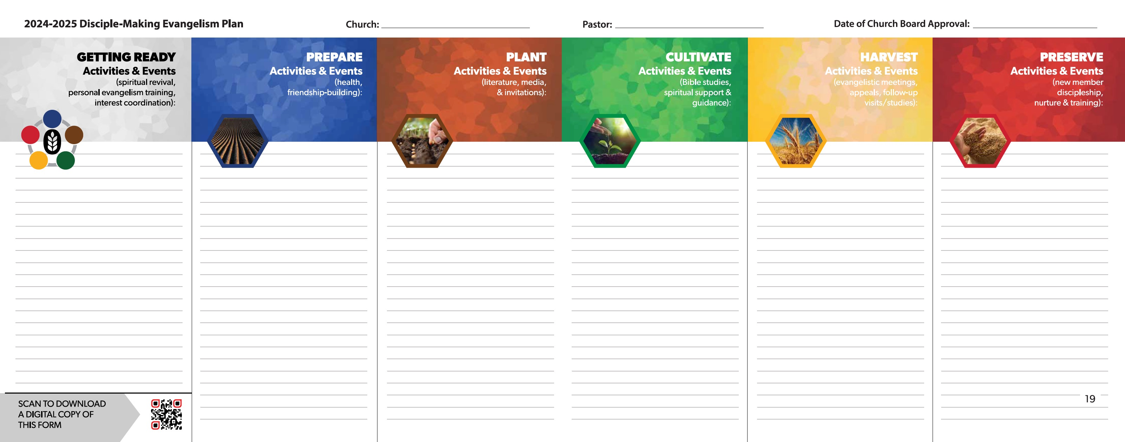
2024-2025 DISCIPLE-MAKING EVANGELISM
Blank Planning Form

Slide 91
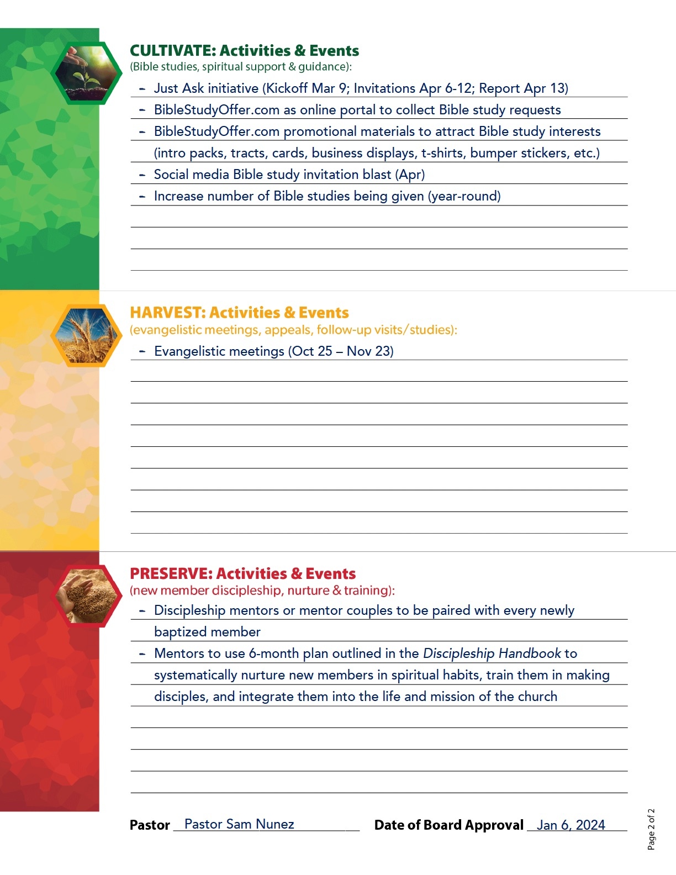
MY LOCAL CHURCH
2024
DISCIPLE-MAKING EVANGELISM PLAN

Slide 92
STEPS FOR ADMINISTRATORS
Promote Global TMI through every platform possible—meetings of administrators, social media, publications, camp meetings, etc.

Slide 93
STEPS FOR ADMINISTRATORS
Supply the Global TMI Church Planner to every pastor
Ask every church to complete the Global TMI planning form
Submit Global TMI Report to higher level of church organization

Slide 94
REPORTING FORM
Conference to Union Officers
We have shared the Global TMI strategy and framework with all our pastors using the Global TMI Church Planner and/or Global TMI website (globaltmi.org).

Slide 95
REPORTING FORM
Conference to Union Officers
We have encouraged every church to submit the 2024-2025 Global TMI Planning Form.

Slide 96
REPORTING FORM
Conference to Union Officers
____________ Number of churches that have submitted a form to participate in Global TMI (with plans for every phase of disciple-making, including reaping meetings).

Slide 97
QUESTION
Are there resources available to help with essential disciple-making ministries?

Slide 98
QUESTION
Are there other resources available to help with essential disciple-making ministries?

Slide 99
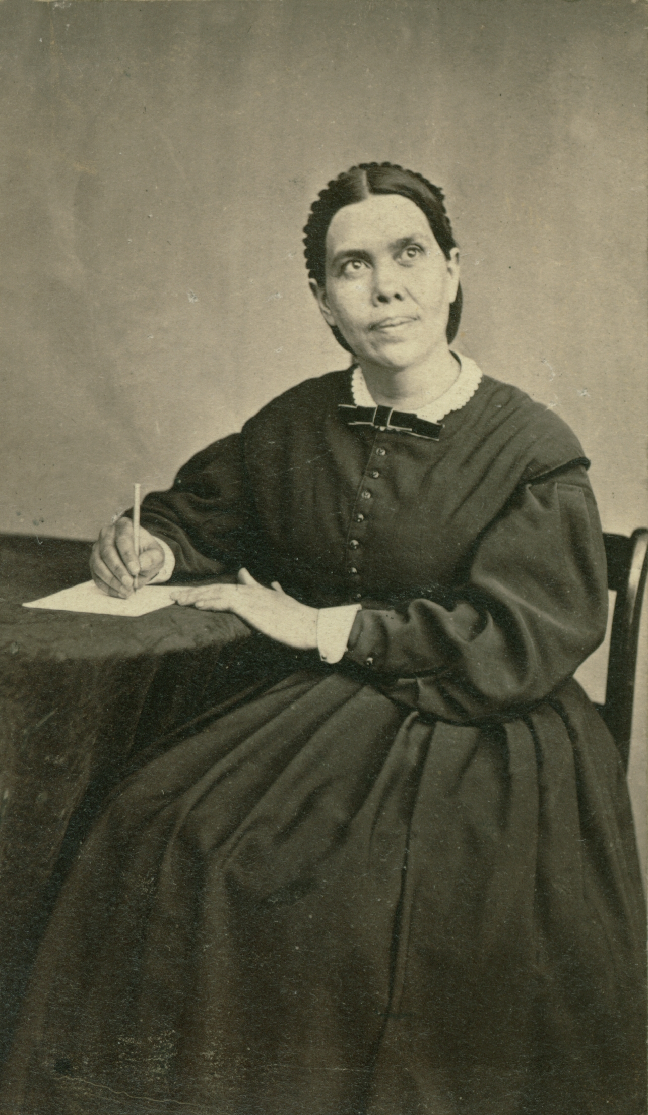
WAUKON, IOWA

Slide 100
WAUKON, IOWA
What doest thou here, Elijah?

Slide 102
CHURCHES AND COMPANIES
(as of December 31, 2022)
Churches
19,240
965
15,816
2,510
5,712
860
15,345
2,338
13,908
Companies
13,223
608
8,501
540
904
212
14,134
4,238
14,175
East-Central Africa Division
Euro-Asia Division
Inter-American Division
Inter-European Division
North American Division
Northern Asia-Pacific Division
South American Division
South Pacific Division
Southern Africa-Indian Ocean Division

Slide 103
CHURCHES AND COMPANIES
(as of December 31, 2022)
Churches
4,594
8,235
1,182
5,156
1,135
62
738
15
97,811
Companies
4,807
3,789
217
5,449
2,864
26
194
5
73,886
Southern Asia Division
Southern Asia-Pacific Division
Trans-European Division
West-Central Africa Division
Chinese Union Mission
Middle East and North Africa Union Mission
Ukrainian Union Conference
Israel Field
Total

Slide 104
“We have no time to lose. The end is near. The passage from place to place to spread the truth will soon be hedged with dangers on the right hand and on the left. Everything will be placed to obstruct the way of the Lord's

Slide 105
“messengers, so that they will not be able to do that which it is possible for them to do now. We must look our work fairly in the face, and advance as fast as possible in aggressive warfare.”
Evangelism, p. 30

Slide 106
8.1 Billion

Slide 107
8.1 Billion

