Slide 1


Slide 2

Disciple-Making
Resources

Slide 3

Assessing the Local Church
Every
Church Has Strengths & Weaknesses

Slide 4
Church Example
A local church holds cooking seminars, VBS and evangelistic meetings every year. It also has an active community service center. Why is it not growing as much as it could?

Slide 5
GROW | Church
Prepare | Health, VBS, Community Services
Plant | NO GROW!
Cultivate
Harvest | Evangelistic Meetings
Preserve | NO GROW!
While holding many church events, this church is weak in vital aspects of personal evangelism such as literature, invitations, Bible studies, and new member discipleship.

Slide 6
Strengthening
Personal Labor
Literature
Invitations
Bible Studies
Baptismal Preparation Studies
Discipleship Mentoring

Slide 7
Literature

Slide 8

Testimonies for the Church vol. 7, p. 139
Literature prepares people to meet God:
“The publications sent forth from our printing houses are to prepare a people to meet God. Throughout the world they are to do the same work that was done by John the Baptist for the Jewish nation.”

Slide 9
Evangelism p. 693
Literature prepares for mass conversions:
“More than one thousand will soon be converted in one day, most of whom will trace their first convictions to the reading of our publications.”

Slide 10
The Power of Literature
It brings souls to Christ (ChS 146).
It goes where ministers cannot go (ChS 153).
It can get around pride (Ev 411).
It is equal in importance to preaching (CM 8).
It lightens the earth at the end of time (7T 140).
It spreads the truth quickly (9T 69).
It breaks down walls of prejudice (LS 214).

Slide 11
Counsels on Health p. 466
Literature equips for Total Member Involvement:
“Tracts, papers, and books, as the case demands, should be circulated in all the cities and villages in the land. Here is missionary work for all to engage in.”

Slide 12
Christian Service p. 145
Literature equips for Total Member Involvement:
“Let every believer scatter broadcast tracts and leaflets and books containing the message for this time.”

Slide 13
How to Run a Local Church Literature Ministry
Develop a literature team.
Choose sharing literature to distribute.
Make literature available to members.
Promote literature distribution from pulpit.
Schedule literature projects and initiatives.

Slide 14

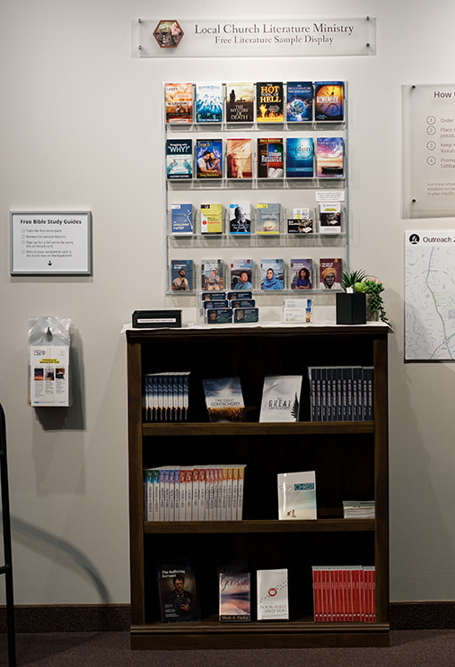
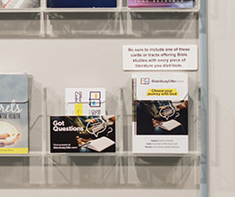
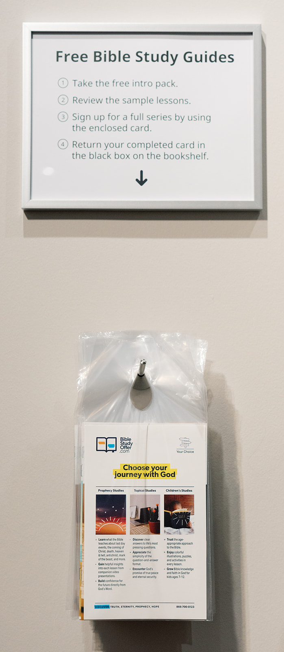
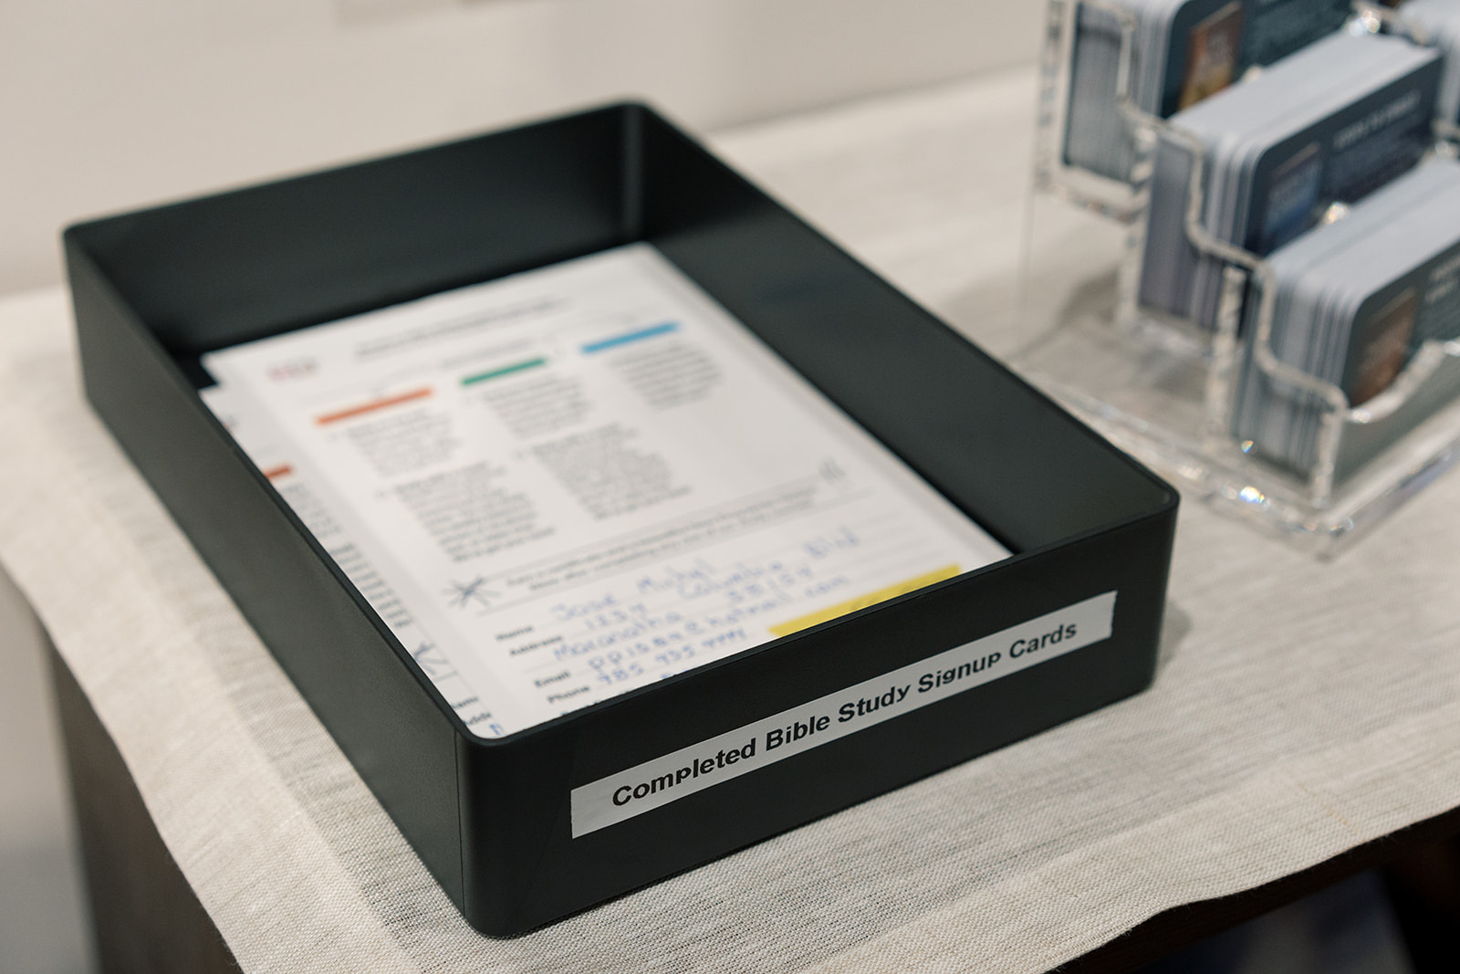

Slide 15
Invitations

Slide 16
The Ministry of Healing p. 143
“Christ’s method alone will give true success in reaching the people. The Savior mingled with men as one who desired their good. He showed His sympathy for them, ministered to their needs, and won their confidence. Then He bade them, ‘Follow Me’ ”

Slide 17
The Ministry of Healing p. 143
“Then He invited them, ‘Follow Me’ ”

Slide 18
Invitations from the Master
Blind men: “What do you want Me to do for you?” (Matt 20:32)
Paralyzed man: “Do you want to be made well?” (John 5:6)
Andrew and John: “Come and see” (John 1:39)
Philip: “Follow Me” (John 1:43)
Rich young ruler: “Come, follow Me” (Luke 18:22)

Slide 19
Jesus INVITED
The regular use of spiritual invitations was central to Jesus’ method of winning souls, and it should be central to ours, too.

Slide 20
Jesus’ Disciples INVITED
“Andrew . . . first found his own brother Simon. . . . And he brought him to Jesus” (John 1:40-42).

Slide 21
Jesus’ Disciples INVITED
“Andrew . . . first found his own brother Simon. . . . And he brought him to Jesus” (John 1:40-42).
Philip to Nathanael: “Come and see” (John 1:46).

Slide 22
Jesus’ Disciples INVITED
“Andrew . . . first found his own brother Simon. . . . And he brought him to Jesus” (John 1:40-42).
Philip to Nathanael: “Come and see” (John 1:46).
“These examples should teach us the importance of personal effort, of making direct appeals to our kindred, friends, and neighbors” (The Desire of Ages, p. 141).

Slide 23
New Believers INVITED
Samaritan Woman: “’Come, see a Man who told me all things that I ever did. Could this be the Christ?’ Then they went out of the city and came to Him” (John 4:29, 30).

Slide 24
We should train members in the Power of Invitation

Slide 25
The Master of Invitation
“A woman of Samaria came to draw water. Jesus said to her, ‘Give Me a drink’” (John 4:7).

Slide 26
3 Ways to Get a Bible Study
You can ask in the morning.

Slide 27
3 Ways to Get a Bible Study
You can ask in the morning.
You can ask in the afternoon.

Slide 28
3 Ways to Get a Bible Study
You can ask in the morning.
You can ask in the afternoon.
You can ask in the evening.

Slide 29
3 Ways to Get a Bible Study
Just Ask

Slide 30
Just Ask!
Ways to Invite:
Personal invitations
Bible study offers at church services and events
Door-to-door invitations
Literature with Bible study offers
Media with Bible study offers
Online and social media ads
Future event flyers
Interest list mailings

Slide 31
The Principle of Planting
“But this I say: He who sows sparingly will also reap sparingly, and he who sows bountifully will also reap bountifully” (2 Cor 9:6).

Slide 32
The Principle of Planting
VOLUME

Slide 33
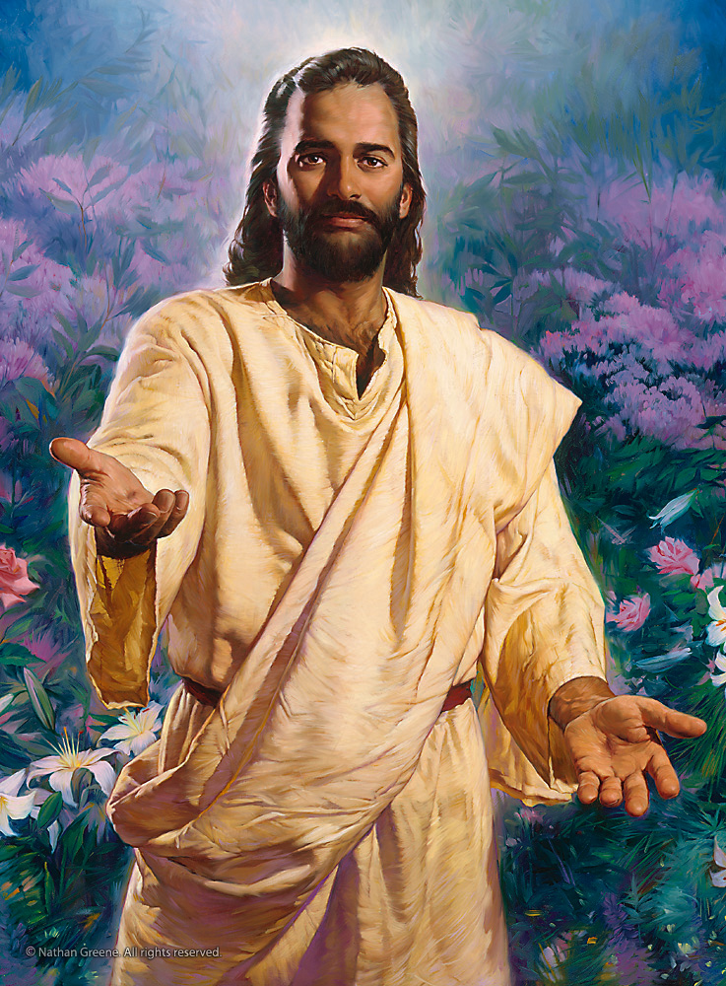
Say, “Come!”
“And the Spirit and the bride say, ‘Come!’ And let him who hears say, ‘Come!’ And let him who thirsts come. Whoever desires, let him take the water of life freely” (Rev 22:17).

Slide 34


Spread the
Word:
A Guide to Personal
Witnessing Through
Conversation,
Literature, Media,
and Other
Seed-Sowing
Activities

Slide 35

Power for Witnessing
Christlike Character
Taking the Initiative
Spiritual Conversations
Sharing Your Testimony
Giving Invitations
Sharing literature
Sharing Media
Organizing Group
Outreach

Slide 36
Bible Studies

Slide 37


Church Social
Community Service
Cooking School
Concert
VBS
Bible Studies
Baptized Disciple
Notes:
Gift of teaching not necessary
Hospitality great!

Slide 38
Christian Service vol. 9, p.121
“Do not lead people to depend upon you as ministers; teach them rather that they are to use their talents in giving the truth to those around them.”

Slide 39
Testimonies for the Church vol. 9, p.126
“In visions of the night representations passed before me of a great reformatory movement among God’s people. . . . Hundreds and thousands were seen visiting families, and opening before them the word of God.”

Slide 40
Christian Service p. 69
“Let ministers teach church members that in order to grow in spirituality, they must carry the burden that the Lord has laid upon them—the burden of leading souls into the truth.”

Slide 41
Christian Service p.144
“Open the Scriptures to some one that is in darkness, and you will not complain of weariness and lack of interest in the cause of truth. Your heart will be awakened to an anxiety for souls, and joy in the evidences of the faith will fill your heart, and you will know that ‘he that watereth shall be watered also himself.’ ”

Slide 42
Christ’s Object Lessons p. 354
“The more one tries to explain the Word of God to others, with a love for souls, the plainer it becomes to himself.”

Slide 43
The Acts of the Apostles p. 109
“Many are on the verge of the kingdom, waiting only to be gathered in.”

Slide 44


The SDA Church Manual simply assumes every church has an active Bible school ministry.

Slide 45
SDA Church Manual, p. 101
Bible School Coordinator—The Bible school coordinator organizes and coordinates the church’s Bible school outreach ministry to the community. The coordinator should work closely with the pastor, the interest coordinator, and the personal ministries leader.

Slide 46
How do I build a “Bible School Outreach Ministry” in my church?

Slide 47


Notes:
In the same way I want our family to go, I want our church to GROW!

Slide 48

a comprehensive tool to help build your Bible school.

Slide 49

Building Your Bible School Ministry
Organize your team.
Train your study leaders.
Generate study interests.
Stock Bible school supplies.
Track Bible study progress.

Slide 50
Building Your Bible School Ministry
Organize your team.

Slide 51
Organizing Your Team
Bible School Coordinator(s)
Orders supplies
Assigns new interests to study leaders
Follows up study interests
Bible Study Leaders
Follows up study interests
Notes:
Coordinators and study leaders have personal BSO accounts with different permissions
Coordinators oversee all aspects of the local Bible school (order supplies, assign new interests to study leaders, etc)
Study leaders only follow up with assigned interests.
All accounts have access to training materials and promotional gear store

Slide 52



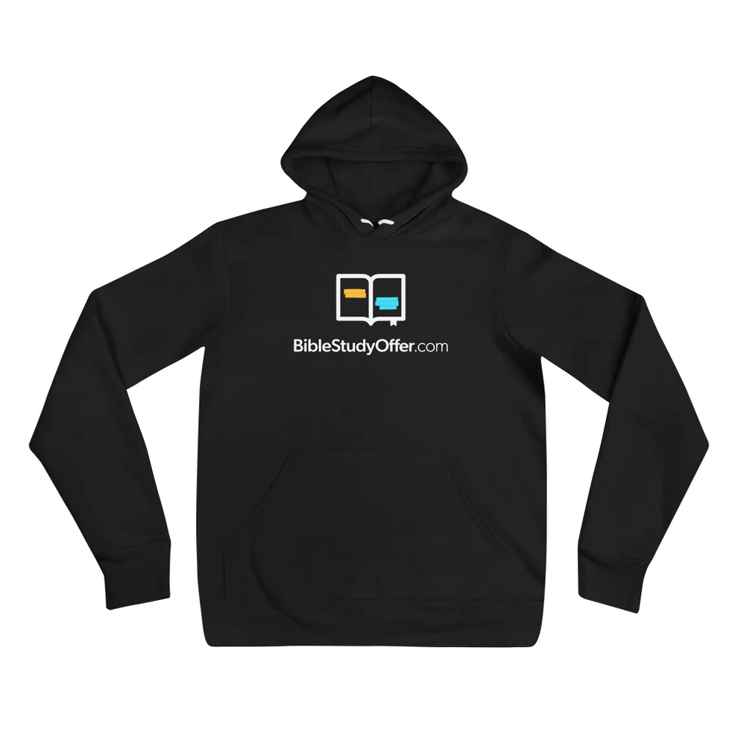
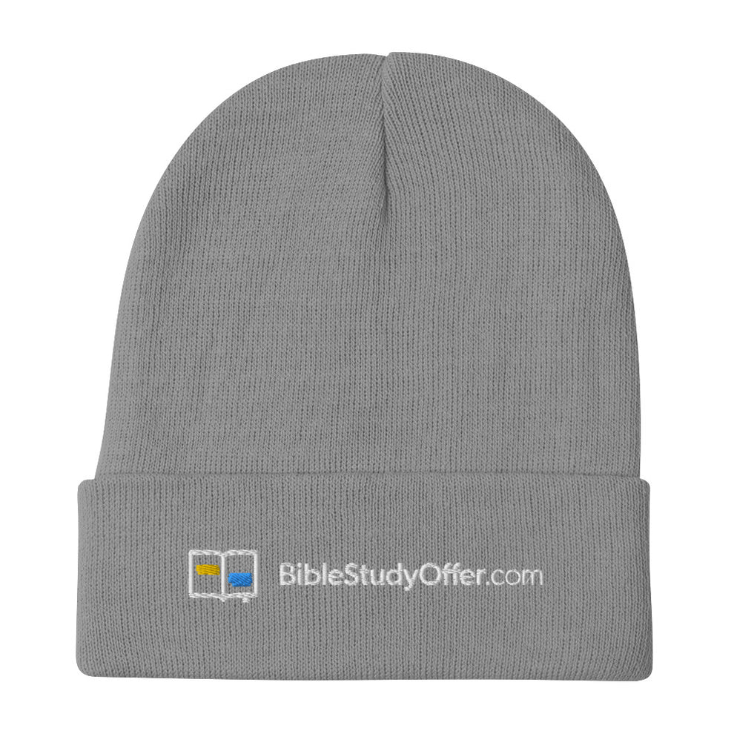
Promotional Gear

Slide 53
Building Your Bible School Ministry
Train your study leaders.

Slide 54
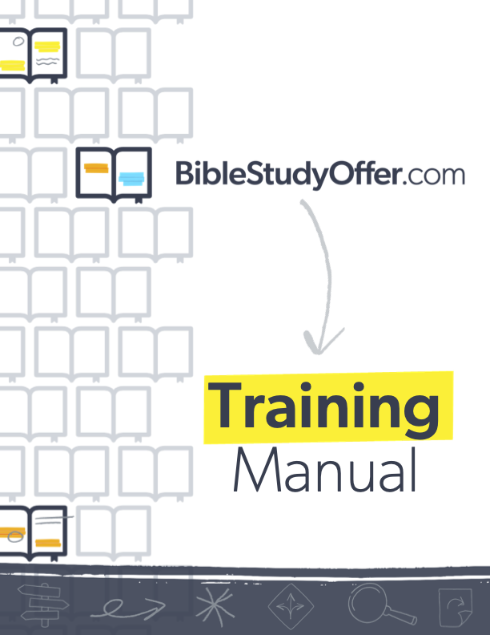


Training Resources

Slide 55
Building Your Bible School Ministry
Generate study interests.

Slide 56












Generate Study Interests
Share BSO social media for free on Facebook and Instagram.
Purchase social media advertising with Virtual Bible Worker

Slide 57


Generate Study Interests
BSO Banners
BSO Pew Cards
BSO Sharing Cards
BSO GLOW Tracts
BSO Direct Mail Handbills

Slide 58
Generate Study Interests
Just Ask!

Slide 59
Building Your Bible School Ministry
Stock Bible school supplies.

Slide 60
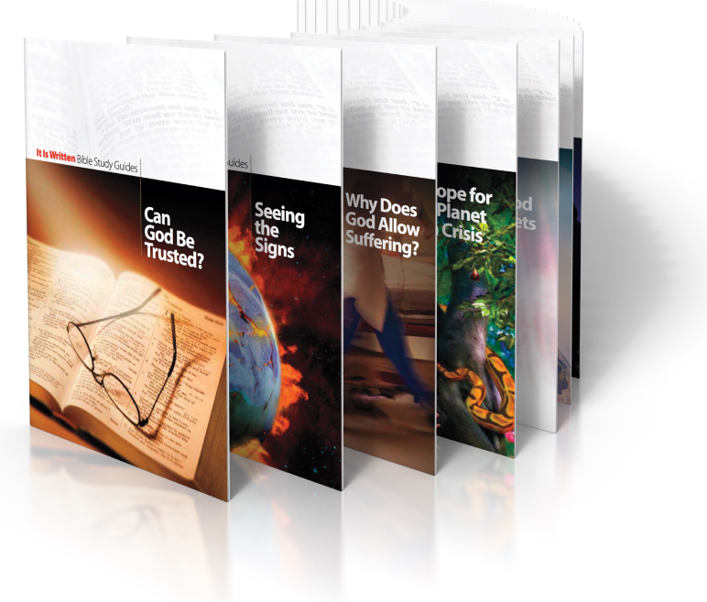
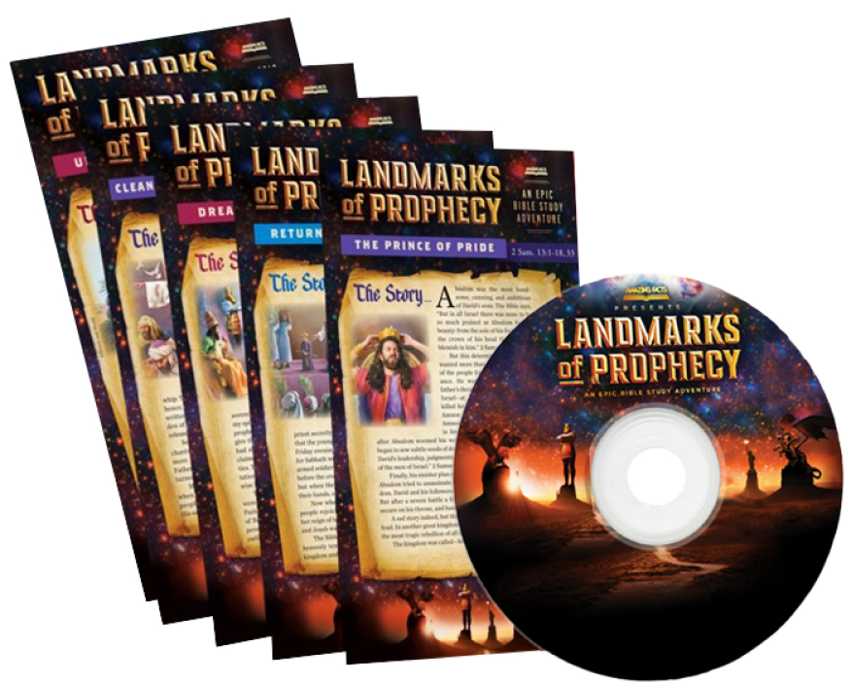
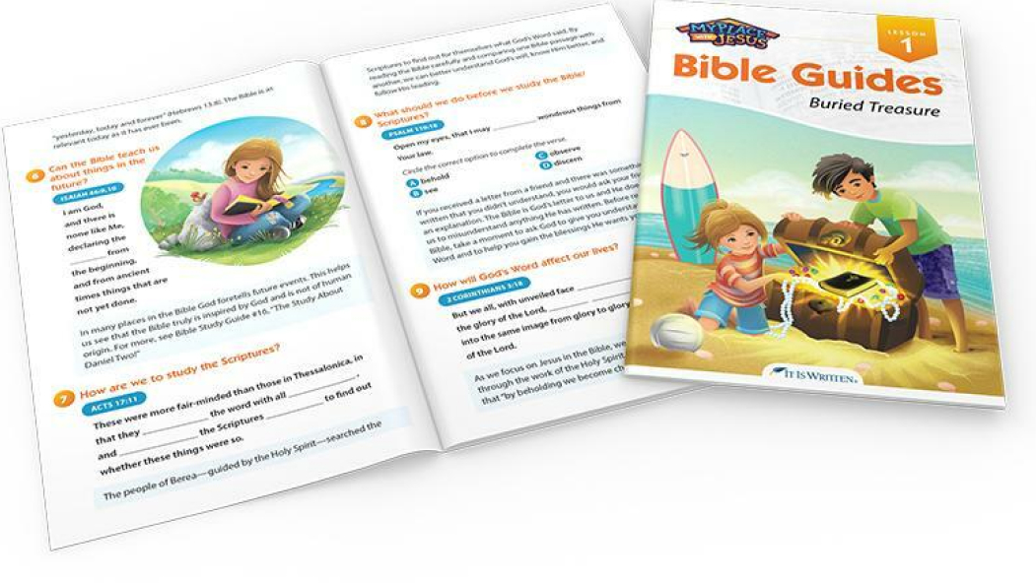
Stock Bible school supplies.
Prophecy
Children’s
Topical

Slide 61
Building Your Bible School Ministry
Track Bible study progress.

Slide 62

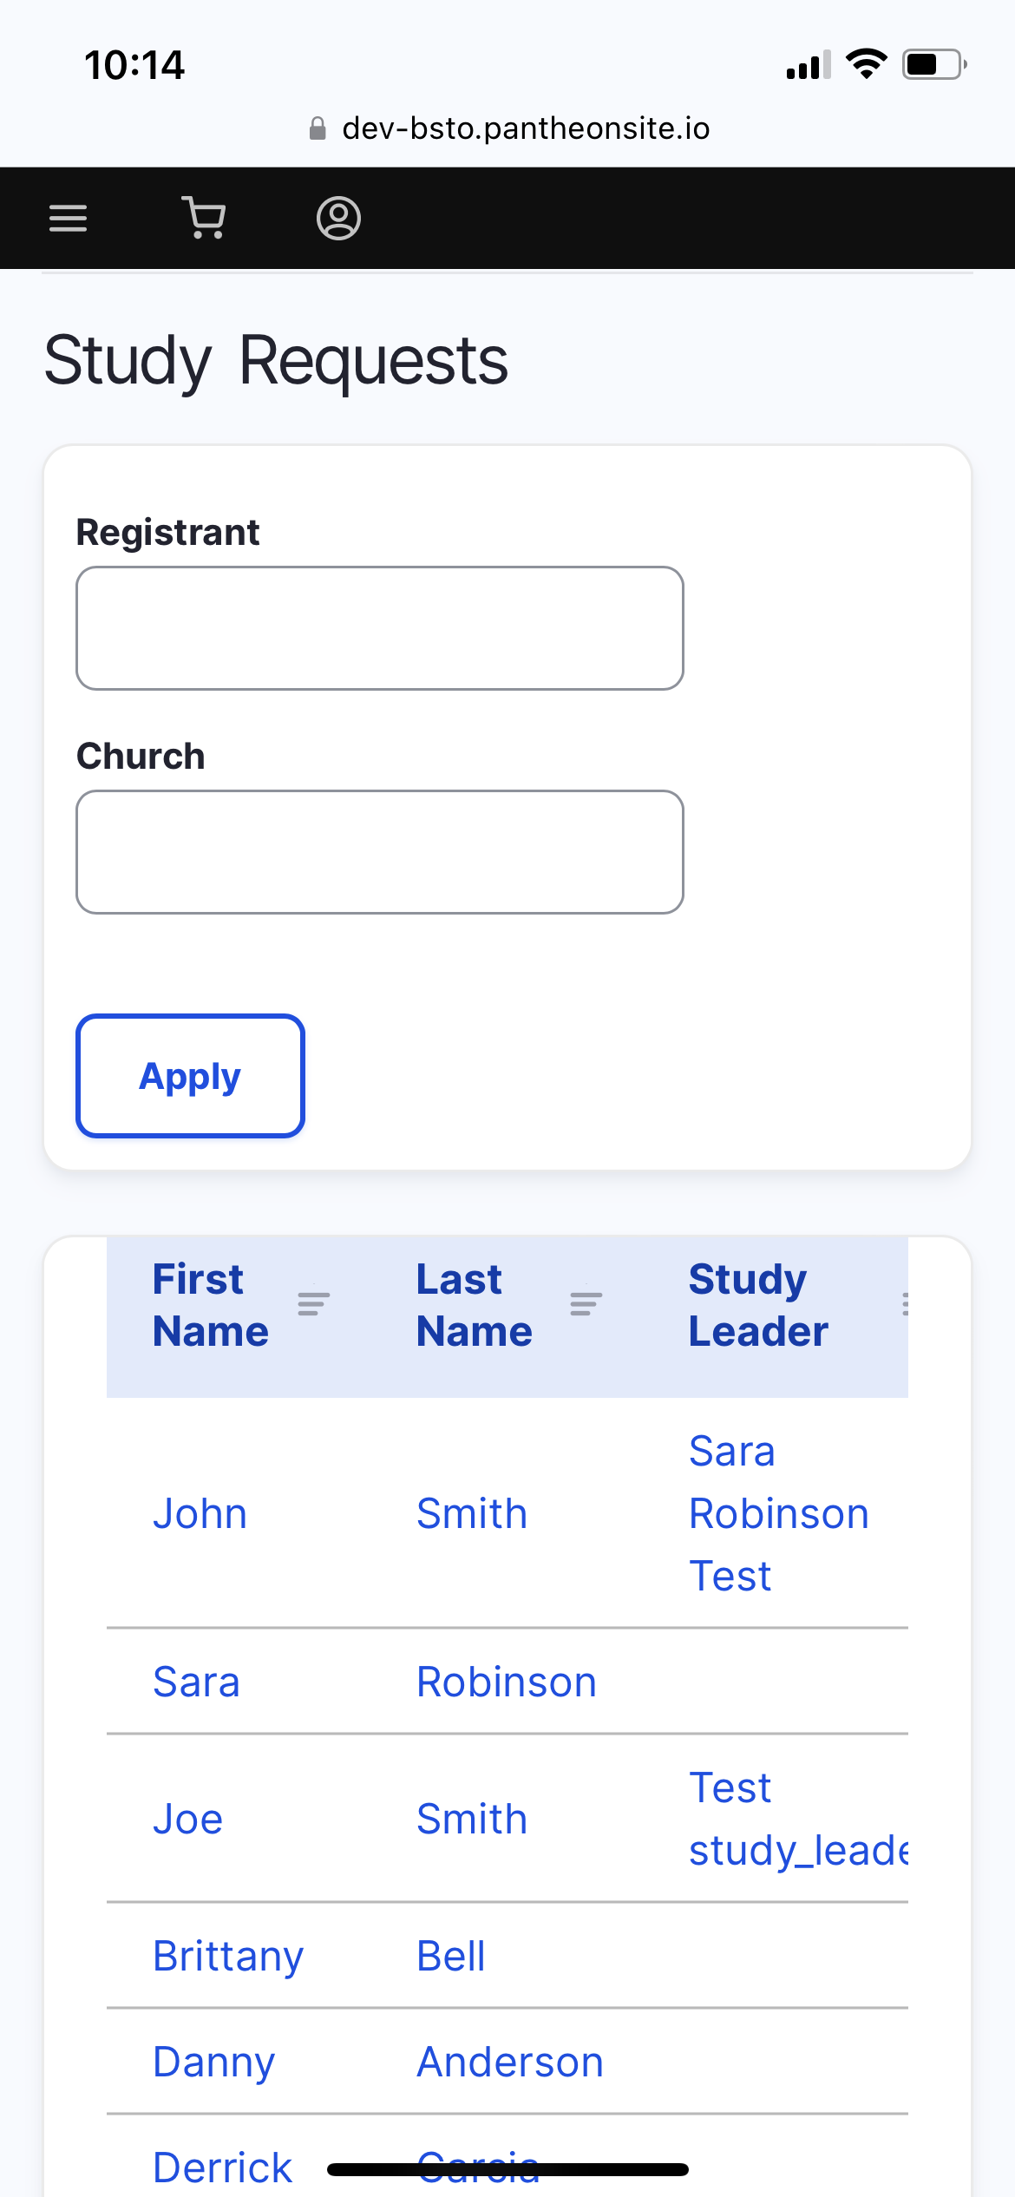
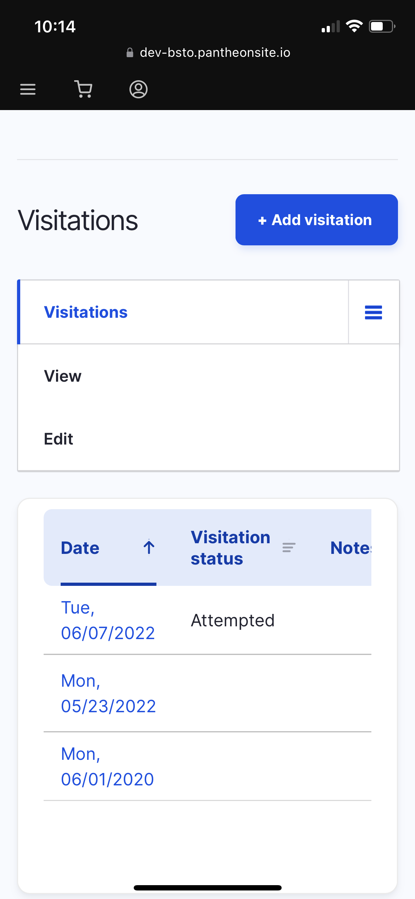
Track Bible Study Progress

Slide 63

Track Bible Study Progress

Slide 64




Better Accountability
Quicker advertised response time.
Email and pop-up reminders for late visits.
Account pausing when visits are overdue.

Slide 65

To get started, scan the code below or visit
BibleStudyOffer.com/info

Slide 66
Bible Studies:
Baptismal Preparation

Slide 67
The Review and Herald
May 21, 1901
“Too much hasty work is done in adding names to the church roll. Serious defects are seen in the characters of some who join the church. Those who admit them say, ‘We will first get them into the church, and then reform them.’ But this is a mistake. The very first work to be done is the

Slide 68
The Review and Herald
May 21, 1901
“work of reform. Pray with them, talk with them, but do not allow them to unite with God’s people in church relationship until they give decided evidence that the Spirit of God is working on their hearts.”

Slide 69
Evangelism p. 311
“Before baptism, there should be a thorough inquiry as to the experience of the candidates. Let this inquiry be made, not in a cold and distant way, but kindly, tenderly, pointing the new converts to the Lamb of God that taketh away the sin of the world. Bring the requirements of the gospel to bear upon the candidates for baptism.”

Slide 70
Pastoral Ministry p. 164
“The test of discipleship is not brought to bear as closely as it should be upon those who present themselves for baptism. It should be understood whether those who profess to be converted are simply taking the name of Seventh-day Adventist, or whether they are taking their stand on the Lord’s side, to come out of the world and be

Slide 71
Pastoral Ministry p. 164
“separate and touch not the unclean thing. When they give evidence that they fully understand their position, they are to be accepted. But when they show that they are following the customs and fashions and sentiments of the world, they are to be faithfully dealt with. If they feel no burden to change their course of action, they should not

Slide 72
Pastoral Ministry p. 164
“be accepted as members of the church. The Lord wants those who compose His church to be true, faithful stewards of the grace of Christ.”

Slide 73
Evangelism p. 320
“God would be better pleased to have six truly converted to the truth . . . than to have sixty make a nominal profession, and yet not be thoroughly converted.”

Slide 74
Evangelism p. 313
“There is one thing that we have no right to do, and that is to judge another man’s heart or impugn his motives. But when a person presents himself as a candidate for church membership, we are to examine the fruit of his life, and leave the responsibility of his motive with himself. But great care should be exercised in accepting members

Slide 75
Evangelism p. 313
“into the church; for Satan has his specious devices through which he purposes to crowd false brethren into the church, through whom he can work more successfully to weaken the cause of God.”

Slide 76


Fundamentals of Faith:
A Summary of
Essential Bible
Doctrines

Slide 77


Covers all 28 fundamental beliefs in an evangelistic order

Slide 78
Includes “My Commitment” points for decisions

Slide 79
Church members can prepare candidates for baptism

Slide 80
Discipleship
Mentoring

Slide 81
Acts 2:40-41
“Then those who gladly received his word were baptized; and that day about three thousand souls were added to them. And they continued steadfastly in the apostles’ doctrine and fellowship, in the breaking of bread, and in prayers.”

Slide 82
Evangelism p. 337
“After individuals have been converted to the truth, they need to be looked after. . . . These newly converted ones need nursing, watchful attention, help, and encouragement. These should not be left alone, a prey to Satan’s most powerful temptations; they need to be educated in regard to their duties, to be kindly dealt with, to be led along, and to be visited and prayed with.”

Slide 83
Evangelism p. 355
“When souls are converted, set them to work at once. And as they labor according to their ability, they will grow stronger.”

Slide 84
Christian Service p. 69
“Let all be taught how to work. Especially should those who are newly come to the faith be educated to become laborers together with God.”

Slide 85
Christian Service p. 69
“One soul, won to the truth, will be instrumental in winning others, and there will be an ever-increasing result of blessing and salvation.”

Slide 86
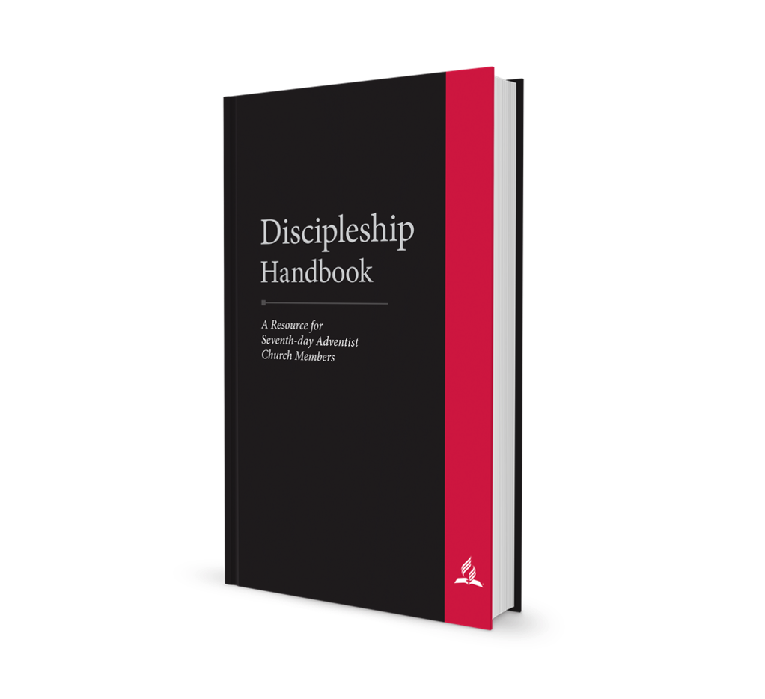

Discipleship Handbook:
A Resource for
Seventh-day Adventist
Church Members

Slide 87
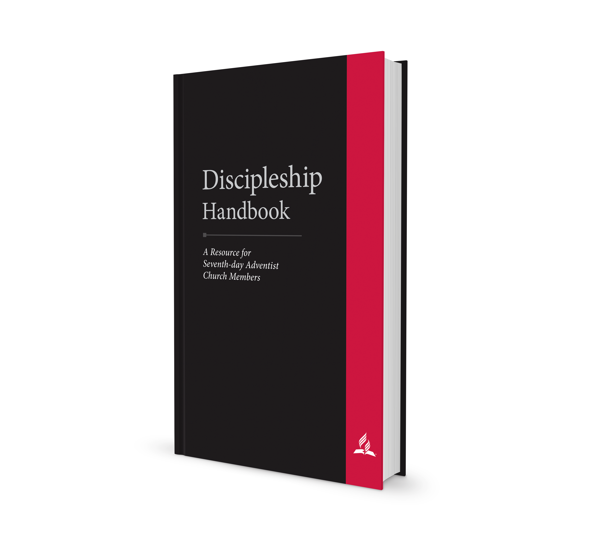
A book to be used in discipleship rather than a book about discipleship
Practice, not Theory

Slide 88
basics:
Contains 26 chapters, an appendix for local leaders and mentors, and a Bible and SOP reading plan

Slide 89
basics:
The 26 chapters correlate to 26 weekly meetings, for a total of 6 months, between mentors and new members

Slide 90
How to Use:
Leaders read through Appendix A, “The Discipleship Plan,” to understand how to implement a simple discipleship plan

Slide 91
How to Use:
Leaders ask current members to read through the book to prepare them to be discipleship mentors

Slide 92
How to Use:
Pair each newly baptized member with a more experienced mentor (same gender or a married couple)

Slide 93
How to Use:
Mentor(s) and new member meet weekly to review one chapter together

Slide 94
How to Use:
Mentors follow weekly outlines (in Appendix A) that recommend various activities to integrate new members into the life and mission of the church

Slide 95
How to Use:
In week two, new member begins reading plan (in Appendix B—provide access to SOP books)

Slide 96
How to Use:
Local church discipleship ministry leader meets or talks to mentors monthly to provide support and accountability

Slide 97
overview:
Discipleship
Bible
Spirit of Prophecy
Prayer
Character

Slide 98
overview:
Family Worship
Identity and Mission of Remnant Church
Witnessing
Church Attendance
Church Ordinances

Slide 99
overview:
Church Organization
Adventist History
Adventist Ministries
Christian Lifestyle
Sabbath Observance

Slide 100
overview:
Reverence
Stewardship
Health
Modesty
Entertainment

Slide 101
overview:
Marriage and Family
Evangelism Cycle
Prepare the Soil
Planting the Seed
Cultivating Interest
Harvest and Preserve

Slide 102
overview:
A. The Discipleship Plan with Weekly Meeting Outlines for Mentors
B. Bible and SOP Reading Plan

Slide 103

Sabbath School Curriculum

Slide 104

SSPM app
iOS and Android
ABSG in more than 70 languages
All age levels in English
Audio and video content
PDF option for taking notes with stylus
Publishing house promotion
Sabbath School Curriculum

Slide 105
SSPM app
iOS and Android
Development:
Personal Ministries books and resources
Bible reading plans and devotionals
Language expansion
Sabbath School Curriculum

