Slide 1
The Big Idea of Preaching
Jud Lake, Th.D., D.Min.
Professor of Preaching and Adventist Studies
Southern Adventist University

Slide 2
Adventist Preaching
A Christ-centered and Sprit-empowered proclamation of an idea from God’s Word, based upon grammatical-historical-theological exegesis and homiletical synthesis, framed by the cosmic conflict worldview, and prayerfully applied to the whole heart for life transformation, first in the preacher, then in the listeners.

Slide 3
Adventist Preaching
A Christ-centered and Sprit-empowered proclamation of an idea from God’s Word, based upon grammatical-historical-theological exegesis and homiletical synthesis, framed by the cosmic conflict worldview, and prayerfully applied to the whole heart for life transformation, first in the preacher, then in the listeners.

Slide 4
Adventist Preaching
A Christ-centered and Sprit-empowered proclamation of an idea from God’s Word, based upon grammatical-historical-theological exegesis and homiletical synthesis, framed by the cosmic conflict worldview, and prayerfully applied to the whole heart for life transformation, first in the preacher, then in the listeners.

Slide 5
Adventist Preaching
A Christ-centered and Sprit-empowered proclamation of an idea from God’s Word, based upon grammatical-historical-theological exegesis and homiletical synthesis, framed by the cosmic conflict worldview, and prayerfully applied to the whole heart for life transformation, first in the preacher, then in the listeners.

Slide 6
Adventist Preaching
A Christ-centered and Sprit-empowered proclamation of an idea from God’s Word, based upon grammatical-historical-theological exegesis and homiletical synthesis, framed by the cosmic conflict worldview, and prayerfully applied to the whole heart for life transformation, first in the preacher, then in the listeners.

Slide 7
Adventist Preaching
A Christ-centered and Sprit-empowered proclamation of an idea from God’s Word, based upon grammatical-historical-theological exegesis and homiletical synthesis, framed by the cosmic conflict worldview, and prayerfully applied to the whole heart for life transformation, first in the preacher, then in the listeners.

Slide 8
Adventist Preaching
A Christ-centered and Sprit-empowered proclamation of an idea from God’s Word, based upon grammatical-historical-theological exegesis and homiletical synthesis, framed by the cosmic conflict worldview, and prayerfully applied to the whole heart for life transformation, first in the preacher, then in the listeners.

Slide 9
Adventist Preaching
A Christ-centered and Sprit-empowered proclamation of an idea from God’s Word, based upon grammatical-historical-theological exegesis and homiletical synthesis, framed by the cosmic conflict worldview, and prayerfully applied to the whole heart for life transformation, first in the preacher, then in the listeners.

Slide 10
Adventist Preaching
A Christ-centered and Sprit-empowered proclamation of an idea from God’s Word, based upon grammatical-historical-theological exegesis and homiletical synthesis, framed by the cosmic conflict worldview, and prayerfully applied to the whole heart for life transformation, first in the preacher, then in the listeners.

Slide 11
Adventist Preaching
A Christ-centered and Sprit-empowered proclamation of an idea from God’s Word, based upon grammatical-historical-theological exegesis and homiletical synthesis, framed by the cosmic conflict worldview, and prayerfully applied to the whole heart for life transformation, first in the preacher, then in the listeners.

Slide 12
Adventist Preaching
A Christ-centered and Sprit-empowered proclamation of an idea from God’s Word, based upon grammatical-historical-theological exegesis and homiletical synthesis, framed by the cosmic conflict worldview, and prayerfully applied to the whole heart for life transformation, first in the preacher, then in the listeners.

Slide 13
Adventist Preaching
A Christ-centered and Sprit-empowered proclamation of an idea from God’s Word, based upon grammatical-historical-theological exegesis and homiletical synthesis, framed by the cosmic conflict worldview, and prayerfully applied to the whole heart for life transformation, first in the preacher, then in the listeners.

Slide 14
Adventist Preaching
A Christ-centered and Sprit-empowered proclamation of an idea from God’s Word, based upon grammatical-historical-theological exegesis and homiletical synthesis, framed by the cosmic conflict worldview, and prayerfully applied to the whole heart for life transformation, first in the preacher, then in the listeners.

Slide 15
Proclamation of a BIG IDEA

Slide 16
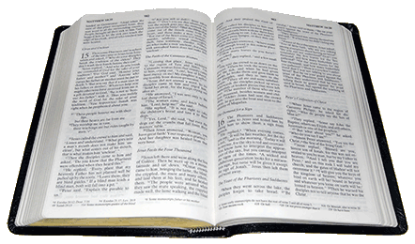
Proclamation of a BIG IDEA FROM GOD’S WORD

Slide 17
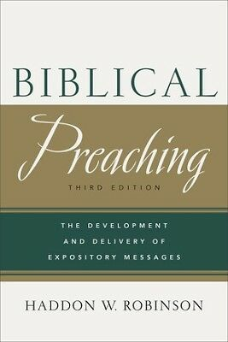

Slide 18
Haddon Robinson
“A sermon should be a bullet, not buckshot.”
Biblical Preaching, 17.

Slide 19
Haddon Robinson
“Ideally each sermon is the explanation, interpretation, or application of a single dominant idea supported by other ideas, all drawn from one passage or several passages of Scripture.”
Biblical Preaching, 17.

Slide 25
Notice how your mind searched for unity,
some wholeness to the parts.

Slide 26
We find it difficult to tolerate chaos or
disunity.

Slide 27
Our propensity toward unity makes trying
to have more than one point (buckshot)
like having no point at all!

Slide 28
The Big Idea
How to find the Big Idea for the sermon:
Exegetical Idea - a past tense statement interpreting what the text meant then.
Homiletical Idea (Big Idea)- a concise statement expressing the timeless, universal truth of the passage in terms relevant to your particular audience.

Slide 29
The Big Idea

Slide 30
Building blocks of an idea
An idea in homiletics consists of two basic building blocks: a subject and complement.
When we talk about the subject of an idea, we mean the complete, definite answer to the question, “What am I talking about?”
A subject cannot stand alone. By itself it is incomplete, and therefore it needs a complement. The complement “completes” the subject by answering the question, “What am I saying about what I am talking about?”

Slide 31
The “subject” of an idea
“Subject” here is used in a nongrammatical sense. The grammatical subject is determined on the basis of the rules of syntax and grammar.
“ Dr. Lake likes to exercise.”
But the homiletical subject is determined on the basis of thought and meaning. Thus, in homiletics the subject of the sermon can NEVER be only one word: “Dr. Lake”

Slide 32
The “subject” of an idea
The subject must offer a full, precise answer to the question, “What am I talking about?”

Slide 33
The “complement” of an idea
A subject cannot stand by itself. It needs a complement to be complete. Thus, the second half of the idea “complements” or “completes” the subject.
A complement, therefore, answers the question, “What am I saying about what I am talking about?”
How does Dr. Lake feel about exercise?”
An idea emerges only when the complement is joined to a definite subject.
“Dr. Lake likes to exercise.”

Slide 34
The “complement” of an idea
Subject: How does Dr. Lake feel about exercise?
Complement: He likes it.
Idea: Dr. Lake likes to exercise.

Slide 35
Building blocks of an idea
Put another way, to have a complete idea you must assert or predicate something about something else. “God loves the world.” As long as you have merely a “something” (a subject), you do not yet have an idea--Gods feeling about the world. It is only the assertion of “another thing” (a complement) about the subject that gives birth to a complete idea.
Subject: How does God feel about the world?
Complement: He loves it!
Idea: God loves the world.

Slide 36
Building blocks of an idea
If the words subject and complement confuse you, then try thinking of the subject as a question and your complement as the answer to that question. The two together make up the idea.
Because the homiletical subject is a question, it should always begin with one of the following interrogatives
Question words: how, what, why, when, where, or who. “Applying these six questions to your proposed subject, will help you be more exact” (Robinson, 40).
The homiletical complement simply answers the appropriate question.

Slide 37
The Big Idea Applied to Matthew 7:21
“Not everyone who says to me, ‘Lord, Lord,’ will enter the kingdom of heaven, but only he who does the will of my Father who is in heaven.” (Matt. 7:21)
Subject: Who does Jesus say will enter the kingdom of heaven?
Complement: Only those who call on Jesus out of a sincere heart and do the will of his father.

Slide 38
The Big Idea Applied to Matthew 7:21
“Not everyone who says to me, ‘Lord, Lord,’ will enter the kingdom of heaven, but only he who does the will of my Father who is in heaven.” (Matt. 7:21)
Exegetical Idea: Only those who call on Jesus out of a sincere heart and do the will of the Father will enter the kingdom of heaven?
Big Idea: Not everyone who is in God’s service is a genuine Christian.
Big Idea: Only those who do the will of God are real Christians.

Slide 39
The Big Idea Applied to Philippians. 4:6-7
“Do not be anxious about anything, but in everything by prayer and supplication with thanksgiving let your requests be made known to God. And the peace of God, which surpasses all understanding, will guard your hearts and your minds in Christ Jesus” (Phil. 4:6,7).
Subject: How should believers address anxious worry in their hearts and minds?
Complement: Instead of worrying about anything, they should take everything to God in prayer with thanksgiving and specific requests and then they will experience God’s peace that surpasses all human understanding and guards their hearts and minds in Christ.

Slide 40
The Big Idea Applied to Philippians. 4:6-7
“Do not be anxious about anything, but in everything by prayer and supplication with thanksgiving let your requests be made known to God. And the peace of God, which surpasses all understanding, will guard your hearts and your minds in Christ Jesus” (Phil. 4:6,7).
Exegetical Idea: When believers are anxious and worried about anything they should instead take everything to God in prayer with thanksgiving and specific requests and then they will experience God’s peace that surpasses all human understanding and guards their hearts and minds in Christ.

Slide 41
The Big Idea Applied to Philippians. 4:6-7
Big Idea: Life is fragile, handle with prayer.
Big Idea: Don’t worry, let God worry for you.
Big Idea: Worry about nothing, pray about everything.

Slide 42
The Big Idea Applied to Psalms 117
“Praise the LORD, all nations! Extol him, all peoples! For great is his steadfast love toward us, and the faithfulness of the LORD endures forever. Praise the LORD” (Ps. 117).
Subject: Why should all nations and all peoples praise the Lord?
Complement: Because of his great and steadfast love toward us and his enduring faithfulness.

Slide 43
The Big Idea Applied to Psalms 117
“Praise the LORD, all nations! Extol him, all peoples! For great is his steadfast love toward us, and the faithfulness of the LORD endures forever. Praise the LORD” (Ps. 117).
Exegetical Idea: All nations and all peoples should praise the Lord because of his great and steadfast love toward us and his enduring faithfulness.

Slide 44
The Big Idea Applied to Psalms 117
“Praise the LORD, all nations! Extol him, all peoples! For great is his steadfast love toward us, and the faithfulness of the LORD endures forever. Praise the LORD” (Ps. 117).
Big Idea: Praise the Lord, for he has earned it!
Big Idea: Praise him for who he is!
Big Idea: Praise the Lord!

Slide 45
The Big Idea Applied to Proverbs 3:5-6
“Trust in the LORD with all your heart, and do not lean on your own understanding. In all your ways acknowledge him, and he will make straight your paths” (Proverbs 3:5-6).
Subject: What is the result of trusting in the Lord with all your heart, not leaning on your own understanding, and acknowledging him in all your ways?
Complement: The Lord will direct your paths or make them straight.

Slide 46
The Big Idea Applied to Proverbs 3:5-6
“Trust in the LORD with all your heart, and do not lean on your own understanding. In all your ways acknowledge him, and he will make straight your paths” (Proverbs 3:5-6).
Exegetical Idea: If you will trust in the Lord with all our heart and not lean on your own understanding and acknowledge him in all your ways, then the Lord will make your paths straight.
Big Idea: Life’s path will lead you astray, trust the Lord and he will guide your way. Or, seek the Lord always and he will guide you in the right path.

Slide 47
The Big Idea Applied to Philippians 4:8
“Finally, brothers, whatever is true, whatever is honorable, whatever is just, whatever is pure, whatever is lovely, whatever is commendable, if there is any excellence, if there is anything worthy of praise, think about these things” (Phil. 4:8).
Subject: How does Paul want believers to think?
Complement: He wants them to think about positive things: what is true, what is pure, what is lovely, what is commendable, anything excellent or worthy of praise.

Slide 48
The Big Idea Applied to Philippians 4:8
“Finally, brothers, whatever is true, whatever is honorable, whatever is just, whatever is pure, whatever is lovely, whatever is commendable, if there is any excellence, if there is anything worthy of praise, think about these things” (Phil. 4:8).
Exegetical Idea: Paul wants believers to think about positive things: what is true, what is pure, what is lovely, what is commendable, anything excellent or worthy of praise.

Slide 49
The Big Idea Applied to Philippians 4:8
“Finally, brothers, whatever is true, whatever is honorable, whatever is just, whatever is pure, whatever is lovely, whatever is commendable, if there is any excellence, if there is anything worthy of praise, think about these things” (Phil. 4:8).
Big Idea: What’s in your mind?
Big Idea: What are you thinking about?
Big Idea: Think well, think right!

Slide 50
Ellen White on Preaching ideas
“Ministers need to have a more clear, simple manner in presenting the truth as it is in Jesus. Their own minds need to comprehend the great plan of salvation more fully. Then they can carry the minds of the hearers away from earthly things to the spiritual and eternal” (Ev 188).

Slide 51
Ellen White on Preaching ideas
“Ministers should become Bible students. Are the truths which they handle mighty? Then they should seek to handle them skillfully. Their ideas should be clear and strong, and their spirits fervent, or they will weaken the force of the truth which they handle” (2T 337).

Slide 52
Ellen White on Preaching ideas
“A man may preach in a spirited manner and please the ear, but convey no new idea or real intelligence to the mind. The impressions received through such preaching last no longer than while the speaker’s voice is heard. When search is made for the fruit of such labor, there is little to be found” (GW 186).

Slide 53
Sermon Design

Slide 54
SERMON
TEXT

Slide 55
TEXT
SERMON

Slide 56
THE POOL ITSELF IS THE TEXT!
THEY JUMP INTO IT AND TAKE THEIR LISTENERS FOR A SWIM
THE TEXT IS THE SERMON

Slide 57
Three Questions Every Expositor Should Ask of the Sermon
What will I say?
Why will I say it?
How will I say it?

Slide 58
Three Questions Every Expositor Should Ask of the Sermon
What will I say? Unity
Why will I say it? Purpose
How will I say it? Structure/Form/Design

Slide 59
Design of the Sermon, H. Grady Davis

Slide 60
Design of the Sermon, H. Grady Davis
A sermon should be like a tree.
It should be a living organism: With one sturdy thought like a single stem With natural limbs reaching up into the light.
It should have deep roots: As much unseen as above the surface Roots spreading as widely as its branches spread Roots deep underground In the soil of life’s struggle In the deeper soil of the eternal Word (15).

Slide 61
Organic
Structure
Natural
Form
Flow
Design

Slide 62
Visible
Sermon
Invisible
Study

Slide 65
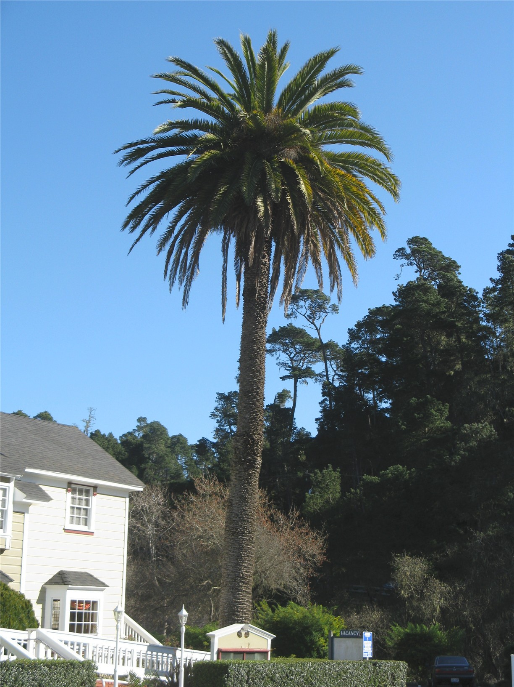

Slide 68
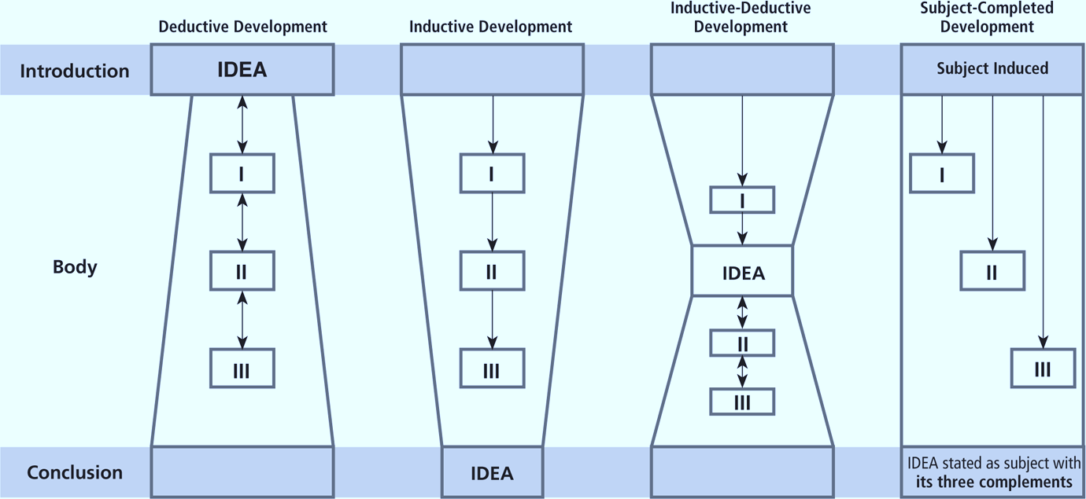

Slide 69
Deductive Form
Statement of central homiletical idea.
I. Division one of main idea.
II. Division two of main idea..
III. Division three of main idea.

Slide 70
Deductive Form: Possible Outlines/Designs
Rhetorical Structure Design
Key Word Design
Verse Slicing Design
Interrogative Design
Verse by Verse Design

Slide 71
Deductive Form: Rhetorical Structure Design
Rhetorical Structure Design: The expositor unfolds the divisions of a textual unit according to its central idea. Each division is stated in a sentence based on specific verses or parts of verses, and is divided into subpoints, according to the subdivisions in the text. This design contains a formal introduction, a body with the divisions, and a climatic conclusion. It seeks to follow the text as closely as possible: the outline of the text is the outline of the sermon.

Slide 72
Deductive Form: Rhetorical Structure Design
Central homiletical idea: With the Lord as your Shepherd, you have everything you need (vs. 1).
I. With the Lord as your Shepherd, you have refreshment (vs. 2).
II. With the Lord as your Shepherd, you have restoration (vs. 3a).
III. With the Lord as your Shepherd, you have righteousness (vs. 3b).
I. With the Lord as your Shepherd, you have courage (vs. 4a).
II. With the Lord as your Shepherd, you have companionship (vs. 4b).
III. With the Lord as your Shepherd, you have comfort (4c).
I. With the Lord as your Shepherd, you have help (vs. 5a).
II. With the Lord as your Shepherd, you have healing (vs.5b).
III. With the Lord as your Shepherd, you have happiness (vs. 5c).
IV. With the Lord as your Shepherd, you have hope (vs. 6a).
V. With the Lord as your Shepherd, you have heaven (vs. 6b).

Slide 73
Deductive Form: Rhetorical Structure Design
Ephesians 3: 14-19:
Central homiletical idea: “God wants to fill your cup to overflowing.”
I. God wants to fill your cup with the empowerment of His Spirit in your mind (vs. 16).
II. God wants to fill your cup with the presence of His Son in your heart (vs. 17).
III. God wants to fill your cup with the power of His love in your life (vs. 17b-19).

Slide 74
Deductive Form: Key Word Design
Key Word Exposition: This is like the traditional outline form and based on Lloyd M. Perry’s method. The difference is the use of a key word that organizes the outline of the sermon. The key word is a plural noun that ties all the main points together, such as reasons, imperatives, truths, motivations, characteristics, benefits, and blessings. For example, “Paul gives us three blessings of prayer. The first blessing in our text is….” The strength of this form is the cohesiveness it brings to the entire sermon.

Slide 75
Deductive Form: Verse Slicing Design
Verse Slicing Design: This deductive form takes one biblical sentence, places it in context, and then slices it into parts that become the major divisions of the sermon.
For example, Isaiah 41:10 could be preached in seven divisions: Fear not/I am with you/Don’t be dismayed/ I am your God/ I will strengthen you/I will help you/I will hold you up with my right hand of righteousness.

Slide 76
Deductive Form: Interrogative Design
Interrogative Exposition: This is structuring an outline with every major division stated in the form of a question. This interrogative design will help explore a subject in an interesting and indirect manner. Like most other deductive designs, it is built around one main idea take from a text. Questions relating to the main idea arise, and selected questions become the major divisions. (Harold T. Bryson).

Slide 77
Deductive Form: Interrogative Design
“The New Birth” John 3:1-15
I. Who needs the new birth?
II. What does it mean to be born again?
III. How can one be born again?
IV. What happens when one is born again?
(Harold T. Bryson)

Slide 78
Deductive Form: Verse by Verse Design
Verse by Verse Design: This is a time-tested classic expository form in which the preacher moves through the text verse-by-verse in a read, explain, illustrate, and apply format. There is no formal organization other than following the verses themselves. It is thus fluid in form and has at its core analysis of the text in its context and application.

Slide 80
Inductive Form
I. Parts and specifics: life-related experiences, analogies, parables, or examples.
II. More parts and specifics: biographical examples, rhetorical questions, narrative.
III. More parts and specifics: other inductive ingredients.
IV. Statement of central homiletical idea.

Slide 81
Inductive Form: Contemporary Experience
Contemporary Experience Journey: Moves from contemporary experience to the biblical text. Most of the sermon is from contemporary experience and the last five to ten minutes is devoted to the climax—the text. Best to use with complex contemporary issues that need analysis, application, and truth at the end.

Slide 82
Inductive Form: Inductive Passage
Inductive Biblical Passage Journey: As shown above induction arrangements can be found throughout the Bible. This design bases the sermon on one of these inductive passages and follows the inductive flow throughout the sermon, ending with the climatic idea in the passage. It simply follows the general arrangement of the text. This design best lends itself to inductive expository preaching. The form of the text is the form of the sermon.

Slide 83
Inductive Form: Inductive Passage
Hebrews 11:
I. In faith, Abel worshiped properly (vs. 4).
II. In faith, Enoch walked with God (vs. 5).
III. In faith, Noah practiced blind obedience (vs. 7).
IV. In faith, Abraham gained an inheritance (vss. 8-10).
V. In faith, Sarah miraculously conceived a nation (vss. 11-12).
VI. Central homiletical idea: “Faith is necessary to please God” (vs. 6).
(Hamilton 99)

Slide 84
Narrative Form
Under the umbrella of inductive sermon forms is the popular narrative form, which essentially tells the biblical story in a relevant and meaningful way (often follows inductive or inductive-deductive movement). In recent years this sermon form has become very popular in Christian pulpits. Its great strength is the love all people have for stories. Much of Scripture is in the narrative genre and the expositor does well to engage it for expository preaching.

Slide 85
Narrative Form: Story-lesson Plot
Story-lesson Plot: The first part of the sermon creatively tells the biblical story. This is usually three-fourths of the sermon time. The second part, the last fourth of the sermon provides several practical lessons from the narrative. This can be done in several ways, but it is essentially inductive-deductive in form. The bullet comes toward the end and its implications are unpacked deductively in the second part. This is a good way to shape a narrative sermon and is a basic form for this genre of preaching.

Slide 86
Story Context

Slide 87
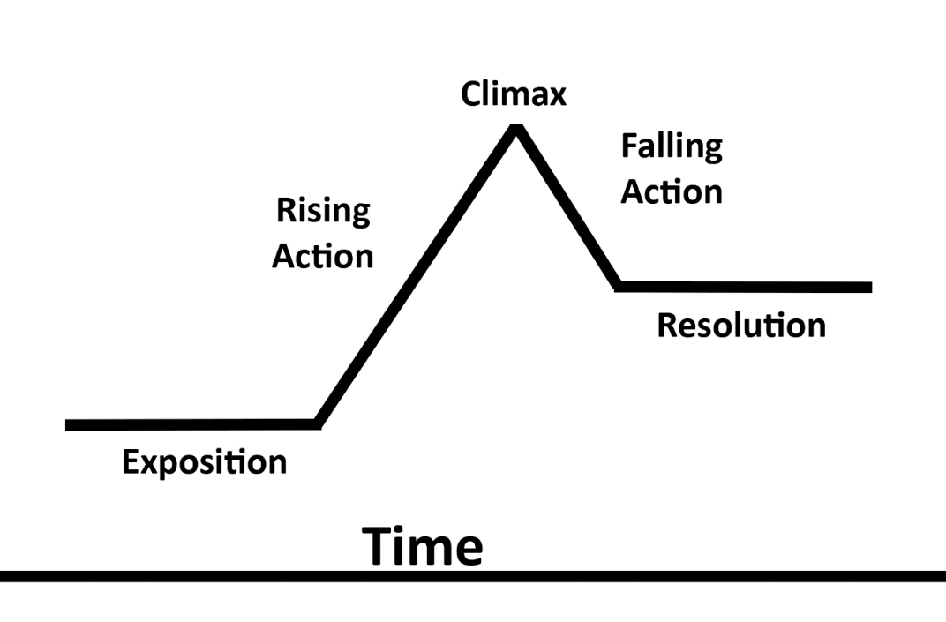
Plot Flow of Biblical Stories
Conflict

Slide 88
Narrative Form: Story-lesson Plot
Genesis 37-50:
I. Story of Joseph creatively told with a focus on his amazing attitude towards his misfortunes
II. Three lessons from Joseph’s experience
A. The working of God is often imperceptible.
B. The working of God is always redemptive.
C. The working of God is progressive.
(Bryson 366)

