Slide 1
Nominating Committee

Slide 2
Credits
Unless otherwise noted, all quoted material is taken from The Seventh-Day Adventist Church Manual, 20th Edition, Review and Herald Publishing Association, 2022.

Slide 3
The Nominating Committee
Purpose
Overview
Establishing the Nominating Committee
Operating the Nominating Committee
Dealing with Objections

Slide 4
The Purpose and Size
"The purpose of the nominating committee is to study the needs of the church and inquire into the fitness of members to serve in the different offices." p116

Slide 5
Overview
The steps of the nominating process are (Church Manual p117-118):
1. The church appoints by vote an organizing committee by one of two methods .
2. The organizing committee recommends names to the church for the nominating committee, with a recommendation for secretary.
3. By vote, the church appoints the nominating committee and the secretary.

Slide 6
Overview Cont'd
4. The pastor or district leader is an ex officio member and serves as chairperson of the nominating committee. Should the pastor or district leader choose not to serve as chairperson, or if a pastor or district leader has not been appointed to the church, the organizing committee shall recommend the name from the proposed nominating committee to serve as chairperson.
5. The nominating committee meets to prepare the list of officers that it will present to the church for approval.
6. By vote, the church appoints its officers for the ensuing year.

Slide 7
Q & A

Slide 8
The Process of Establishing a Nominating Committee
Preparation
Establishing an Organizing Committee
Establishing the Nominating Committee

Slide 9
Preparation
"The nominating committee should be appointed early in the closing quarter of the election term and should report at least three weeks before the final Sabbath of the election term, except in the case of a standing nominating committee, which functions year-round." p116
"The pastor or district leader or, in the absence of the pastor or district leader, the elder should bring the matter to the attention of the church." p116
What about VLPs?

Slide 10
Organizing Committee
"The church shall then appoint an organizing committee responsible to nominate the nominating committee. This organizing committee may be chosen in one of two ways:" p117
1. The organizing Committee may be comprised of the Church Board PLUS 5 to 7 individuals elected by the congregation to serve in this capacity.
2. The Organizing Committee may be comprised strictly of individuals elected to serve in this capacity.
It is recommended the size of the organizing committee in this case be the number of the church board PLUS 5-7

Slide 11
Selecting the Organizing Committee
Nominations may be taken from the floor during the regularly scheduled Worship meeting on Sabbath morning or during a Business Meeting.
"If verbal nominations are made, no member may nominate more than one person" p117
Secret Ballot

Slide 12
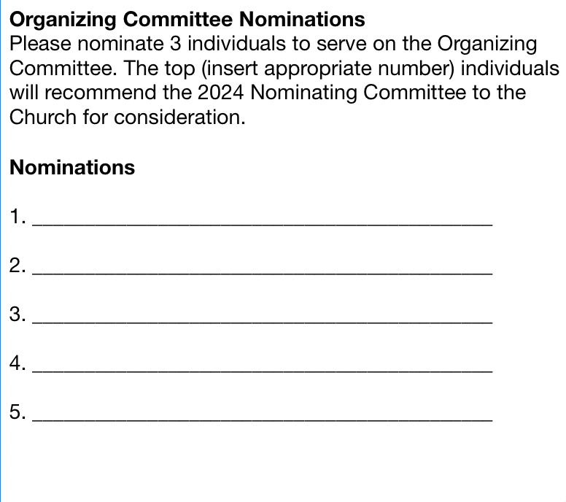

Slide 13
Selecting the Organizing Committee
Nominations may be taken from the floor during the regularly scheduled Worship meeting on Sabbath morning or during a Business Meeting.
"If verbal nominations are made, no member may nominate more than one person" p117
Secret Ballot
Tally Ballots and Report

Slide 14
Practical Considerations
"Everything of a political nature should be avoided." p117
"The pastor or district leader shall serve as chairperson of this organizing committee. If a pastor or district leader has not yet been appointed to serve as church leader, the chairperson of this organizing committee shall be appointed by the board from among the members of the organizing committee." p117
What about VLPs?

Slide 15
Members and Size of the Nominating Committee
"Only members in regular standing should be chosen to serve on the nominating committee. They should be persons of good judgment who have the welfare and prosperity of the church at heart." p118
"Every effort should be made to ensure fair representation in the composition of the organizing committee." p117
The composition of the the nominating committee will "range in size from five members in a small church to a larger number in a large church. The number to be chosen is left to the discretion of each church and should be studied by the board. A suitable recommendation then will be brought to the church, using a minimum of time in the Sabbath worship hour." p116

Slide 16
Q & A
What about church politics?
What about VLPs?

Slide 17
Work of the Nominating Committee
Should be timely
Should be prayerful
Should consider fitness to serve
May be done in the counsel the of the "well informed"

Slide 18
Practical Considerations
The church should select the positions to be filled.
The Sabbath School Council selects Sabbath School teachers.
It is mandatory to get consent from the prospective nominee.
Members may "appear before the nominating committee to make suggestions or objections" p119
Discussions take place after the person wishing to make a suggestion or objection has retired from the committee.

Slide 19
Confidentiality
"All inquiries and discussions of the committee are confidential. It is a violation of Christian ethics and the spirit of the golden rule for a member of the committee to repeat outside of the committee any personal or sensitive information discussed. To offend in this regard is reason for excluding the committee member from future participation in the work of a nominating committee. Should the necessity arise for inquiries to be made outside the committee, the chairperson should make them."

Slide 20
The Nominating Committee Report
The first reading of the nominating committee report is made to the church as a whole either in a regularly scheduled worship service or in a duly called Business Meeting.
The church board has no jurisdiction in this process.
It is the responsibility of the chairperson of the nominating committee to make the appropriate remarks when the report is presented to the church and to inform the church when the second reading and subsequent vote will be held (typically 1 to 2 weeks from initial presentation).
It is the responsibility of the secretary of the nominating committee to either give the church membership a written copy of the report, to read it aloud before the church, or both.

Slide 21
Q & A
Who has the final say on all matters pertaining to the nominating committee?

Slide 22
Objections
Once the report is made public, any church member may object.
It is the responsibility of the objector to make his/her concerns known in the presence of the nominating committee.
It is the responsibility of the chairperson to make appointments with objectors to appear before the nominating committee to voice his/her concerns.
Discussions pertaining to concerns do not take place in the presence of the objector.

Slide 23
Objections cont'd
If an objection is made, at the time of the second reading, the report MAY be referred back to the committee.
Hearing concerns does NOT take place in the presence of the church.
It is the responsibility of the chairperson of the nominating committee in consultation with the nominating committee to establish and announce a time and place to hear the concerns of the aforementioned objector(s).
Once the objections have been considered, And the committee has exercised its judgment as to what, if any, changes are necessary, the report is to be referred back to the church, and, barring any further objections, a vote is called.
A majority vote is required for passage.

Slide 24
Q & A
What if...

Slide 25
Filling Vacancies Between Elections
If an office of the church becomes vacant during the term of office because of death, removal, resignation, or any other reason, the board nominates a successor to fill the vacancy for the remainder of the term of office and submits the nomination to the church for election. p120
The church may decide based on its needs that it would be best served with a standing nominating committee. As such, it may appoint such a committee which would function year-round to make nominations for vacancies or to fill regular positions identified in the Church Manual. p116

Slide 26
Lessons Learned
Kyle
Ken
Dysfunction

